Slide 1
Great people

Slide 2
Euclidean algorithm
Ο Ευκλείδειος Αλγόριθμος είναι ένας τρόπος για να βρεθεί ο μέγιστος κοινός διαιρέτης δύο αριθμών. Πήρε το όνομά του από τον Έλληνα μαθηματικό Ευκλείδη.
PROBLEM
Imagine you're a teacher organizing a school trip. You have 48 students and need to divide them into groups for transportation. You want to ensure that each group has the same number of students, to make the trip fair and efficient. However, you also want to make sure that no students are left out of the groups.In this scenario:
The total number of students (48) represents a.
The number of students per group (let's say, b) represents b.

Slide 3
Problem solving
Solution: The Euclidean algorithm is an efficient method for finding the greatest common divisor of two integers. Here's how it works:
Take two positive integers, let's call them a and b, where a is greater than or equal to b.
Divide a by b and find the remainder. Let's denote this remainder as r.
Replace a by b and b by r.
Repeat steps 2 and 3 until b becomes zero. At this point, the value of a will be the GCD of the original two integers.

Slide 4
Given a=48 and b=18:
48÷18=2 with remainder 12. So, r=12.
Now, replace a with b (18) and b with r (12).
18÷12=1 with remainder 6. So, r=6.
Replace a with b (12) and b with r (6).
12÷6=2 with remainder 0. So, r=0.
Since the remainder is now zero, the GCD of 48 and 18 is the last non-zero divisor, which is 6. Therefore, GCD(48,18)=6.

Slide 5
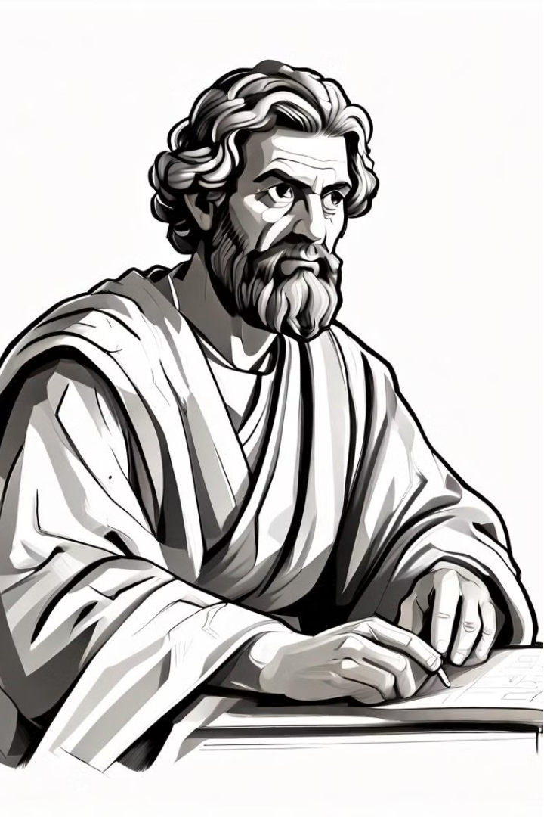

Euclid: The Father of Geometry
Euclid, an ancient Greek mathematician, is renowned as the "Father of Geometry" for his groundbreaking contributions to the field of mathematics.

Slide 6
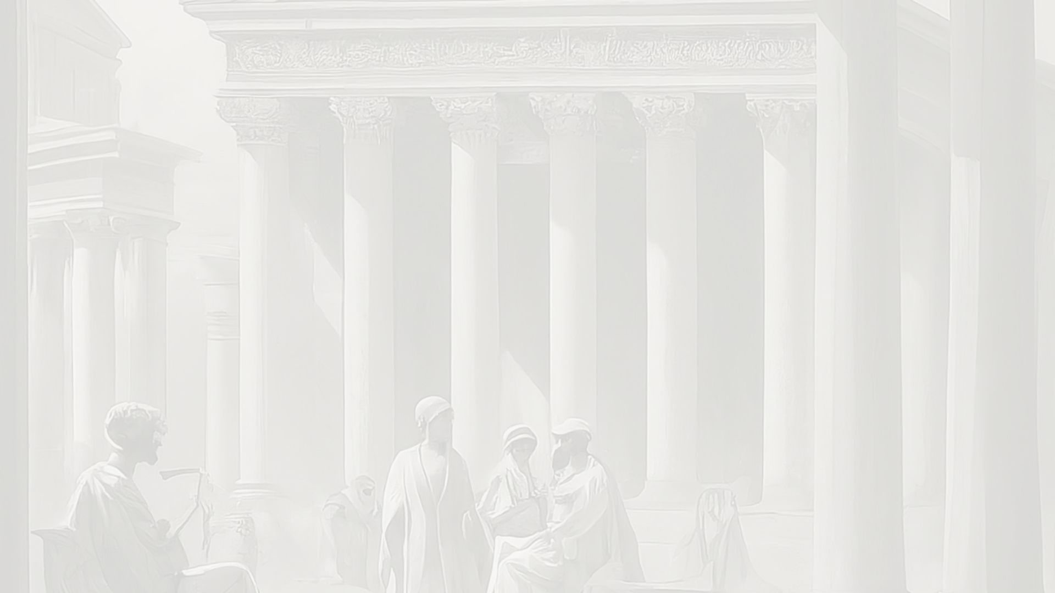
Early Life and Education
Birth and Childhood
1
Euclid was born around 325 BC in the ancient Greek city of Alexandria, Egypt.
2
Education
He received his early education in Athens, studying under the renowned mathematician Plato.
Teaching Career
3
Euclid later returned to Alexandria, where he founded a renowned school of mathematics and became a highly respected teacher.

Slide 7
Contributions to Mathematics
Euclidean Geometry
Number Theory
Euclid's most famous work, "Elements," established the foundational principles of Euclidean geometry, which dominated the field for centuries.
Euclid made significant contributions to number theory, including the proof of the infinitude of prime numbers.
Optics and Astronomy
Legacy
Euclid also wrote treatises on optics and astronomy, further expanding the scope of his mathematical expertise.
Euclid's "Elements" remains one of the most influential and widely studied works in the history of mathematics.

Slide 8
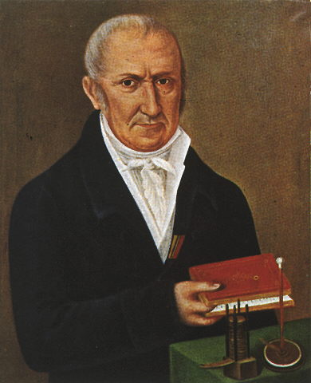
Alessandro Volta
Alessandro Volta was an Italian scientist who made many important discoveries in the field of electricity. He was born on February 18, 1745, in Como, Italy. Even though his family wanted him to become a lawyer, Volta was more interested in science. He became fascinated with electricity when he was a teenager and decided to study physics. Volta dropped out of school and started doing experiments with electricity. He even corresponded with other scientists and wrote papers about his theories.
One of Volta's most famous inventions was the electric battery, which he called the "voltaic pile". This invention allowed scientists to produce a steady flow of electric current for the first time. It was a big breakthrough in the field of electricity. Volta also discovered methane, a type of gas, and found out that it could be exploded using an electric spark. This discovery later became the basis for the internal combustion engine.
Volta was a very respected scientist and was even invited to demonstrate his inventions to important people like Napoleon Bonaparte. He held a teaching position at the University of Pavia for almost 40 years and was loved by his students. Volta died in 1827, but his contributions to science are still remembered today. In fact, the unit of electric potential is named after him - it's called the volt. Alessandro Volta was a brilliant scientist who made many important discoveries and inventions that have shaped the world of electricity.

