Slide 1

Optimism in Song: Creating Good Vibes Messages

Slide 2

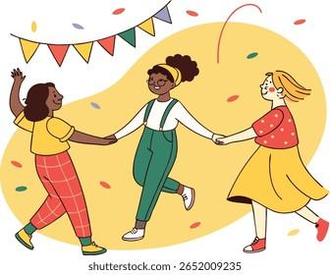
Welcome Optimism Ambassadors!
Καλώς ήρθατε! Welcome to our journey of spreading positivity
Today you will become Ambassadors of Optimism
Greek and Swedish students united by the power of positive messages
Opening Circle: Share your name and one word that makes you happy in your native language
Notes:
Image from: https://issuu.com/fountainvalleyschoolofcolorado/docs/international_student_program_brochure_may_2025_

Slide 3

The Power of "Καλημέρα" (Kalimera)
“Kalimera, ti kaneis?/ "Good morning, how are you doing?" - A simple greeting with deep meaning
Every greeting is an opportunity to spread joy
When you wake up and you greet your family or friends, what is the very first thing you say in your language?
Notes:
Image from: https://in.pinterest.com/pin/good-morning-quotes-with-nature-background--79516749666747184/

Slide 4
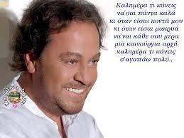
Καλημέρα, τι κάνεις; — Good morning, how are you?- God morgon! Hur mår du?
It’s a song by a legendary artist named Yiannis Parios.
Parios is often called the 'Greek Sinatra' because of his powerful, romantic voice, and he is one of the most popular singers in Greece, especially known for his emotional songs about love, life, and optimism.
This song is full of 'good vibes' and useful phrases, and we're going to unpack them together.
Let's listen to the chorus first!

Slide 5
Key Optimistic Words from Our Song
We are going to listen to the song one more time, but this time with a mission.
I am handing out the lyrics now—Greek on one side, English translation on the other.
Your task during this listening is to act like a detective:
Using a pen, circle all the Greek words or short phrases that express a direct GREETING or a POSITIVE/ENCOURAGING feeling.

Slide 6
Key Optimistic Words from Our Song
"Be well always“/ - Wishing continuous wellness
"I love you very much“ - Expressing deep care
"New beginning" - Every day offers fresh starts
"Don't lose your courage" - Maintaining strength
"Head up" - Standing proud and confident

Slide 7
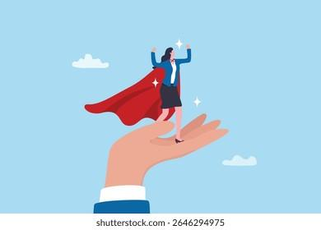
Messages of Encouragement
Using the key vocabulary and positive spirit from Yiannis Parios's song, your goal is to create a series of powerful Good Vibes Messages: Think of them as encouraging phrases you would send to a friend who is having a tough time.
Remember, your messages must incorporate key Greek phrases from the song, combined with your best English and Swedish expressions.
Notes:
Image from: https://www.shutterstock.com/image-vector/woman-empowerment-encouragement-support-help-achieve-2646294975

Slide 8
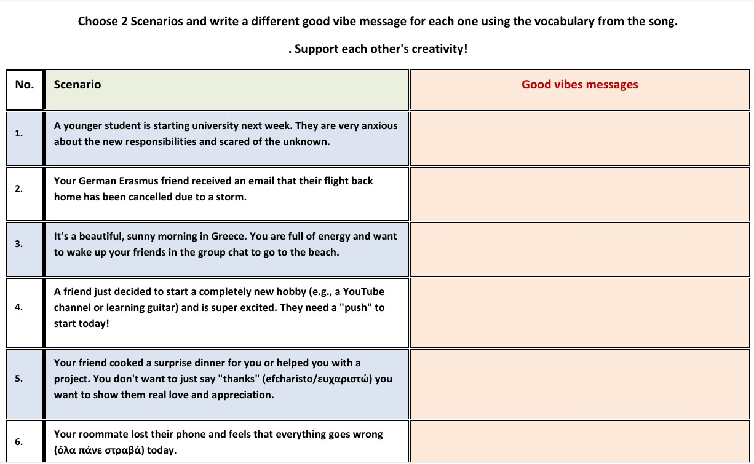
Messages of Encouragement
Notes:
Image from: https://www.shutterstock.com/image-vector/woman-empowerment-encouragement-support-help-achieve-2646294975

Slide 9
Good Vibes Message Structure
Start with a warm greeting
Add an encouraging statement
Include a wish for the future
End with love or support
Example: "Hello sunshine! Keep your dreams alive. Tomorrow brings new possibilities. You are amazing!"

Slide 10
Messages of Encouragement examples
"Don't lose your courage, head up" - Building resilience
"Something will always happen" - Trust in positive outcomes
"Don't ask why" - Sometimes faith is enough.
Notes:
Image from: https://www.shutterstock.com/image-vector/woman-empowerment-encouragement-support-help-achieve-2646294975

Slide 11
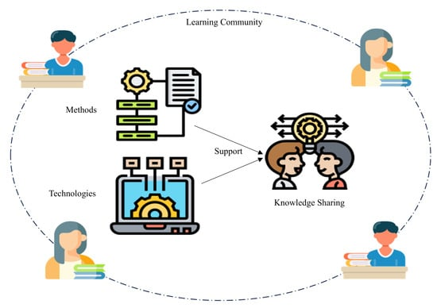
Sharing Circle: Your Good Vibes Messages
Each pair presents their favorite message to the group
Explain what inspired your creation
Listen actively and appreciate others' creativity
Appreciations Protocol: Recognize effort, creativity, and positive energy in each message
Notes:
Image from: https://www.mdpi.com/2076-3387/14/1/17

Slide 12
Reflection: Becoming Optimism Ambassadors
How did creating positive messages make you feel?
What did you learn about optimism from your international partner?
Reflection Questions: "What will you do differently tomorrow to spread good vibes?"
Learning Target Check-in: Can you create encouraging messages that inspire others?

Slide 13
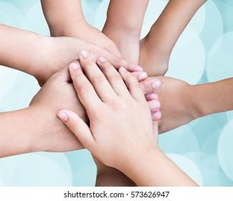
Closing Circle: Spreading the Good Vibes
Share one Good Vibes Message you'll take home
Commit to being an Optimism Ambassador in your daily life
Exchange contact information to continue spreading positivity
Καλημέρα! Kalimera!
God morgon! Good morning to a brighter future!
Ευχαριστώ! Efcharisto! Thank you!
Notes:
Image from: https://www.shutterstock.com/image-photo/children-students-hands-stacking-together-harmonious-573626947

