Slide 1
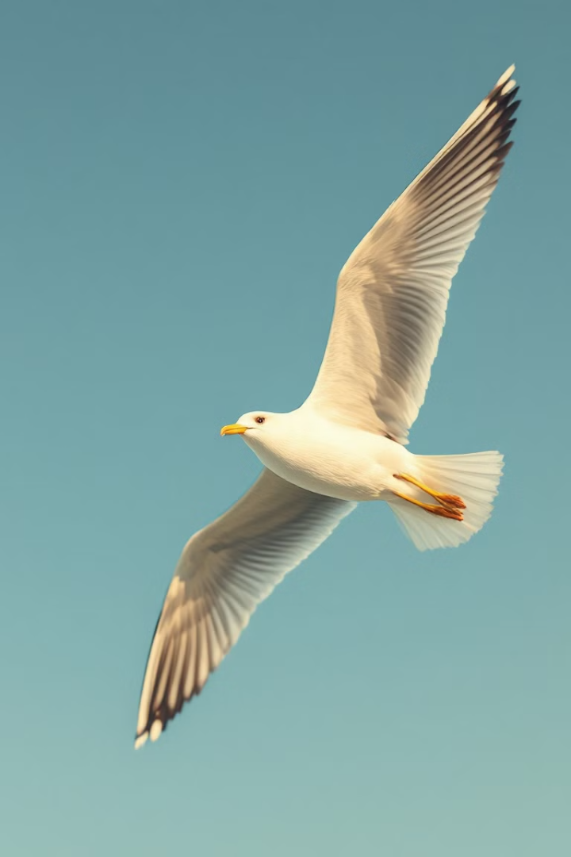

Jonathan Livingston Seagull
Jonathan Livingston Seagull is a novel about a bird's journey of self-discovery. It explores themes of nonconformity, self-improvement, and overcoming societal expectations.
by Αναστασια Καραδιαμαντη

Slide 2
Richard Bach: Author of Jonathan Livingston Seagull
Early Life and Influences
Writing Style and Themes
Bach was born in Chicago in 1936 and served as a fighter pilot in the US Air Force.
Known for philosophical and spiritual themes, he often uses animals as metaphors for human struggles.

Slide 3

Jonathan's Unconventional Journey
Passion for Flight
Rejection and Exile
Jonathan, unlike other gulls, yearns to explore the limits of flight.
His unique aspirations lead to ostracism from his flock.
The Pursuit of Excellence
He embarks on a solitary journey of practice and self-improvement.

Slide 4

Nonconformity and Self-Improvement
Embracing Individuality
The Power of Determination
Transcending Limitations
Jonathan's journey encourages readers to embrace their own unique paths.
Despite facing adversity, he persists in his pursuit of excellence.
He demonstrates that even seemingly insurmountable challenges can be overcome.

Slide 5



Embracing Your True Potential
Discover Your Passion
1
Identify your unique talents and pursue what truly excites you.
Seek Mentorship
2
Find guidance and support from those who have achieved their dreams.
Embrace the Journey
3
The path to achieving your potential is often challenging, but rewarding.

Slide 6
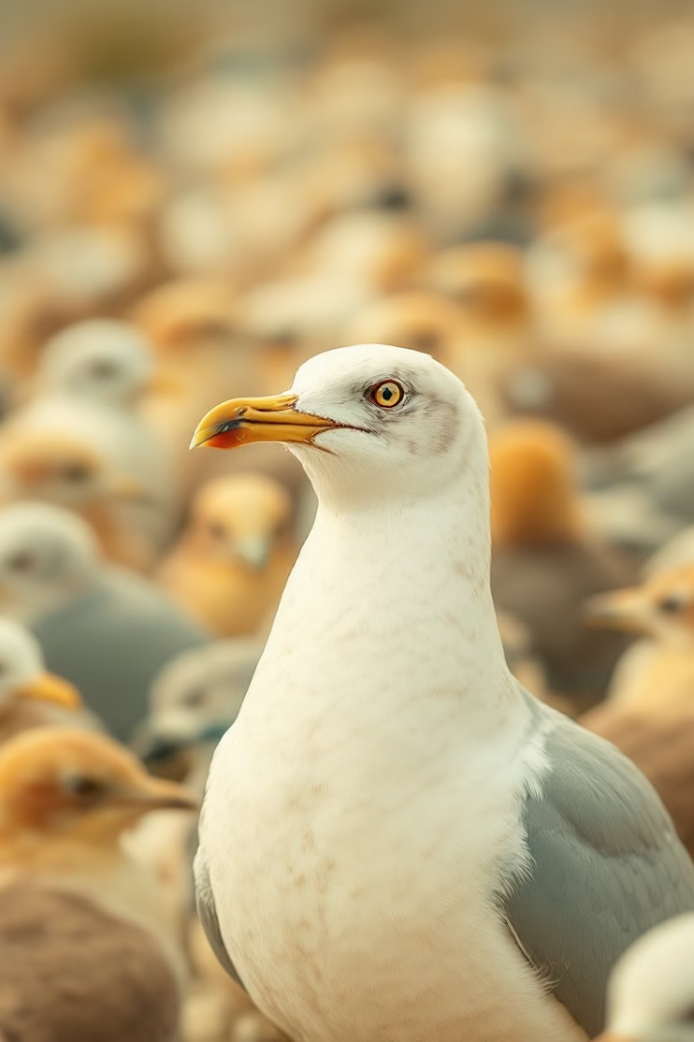



Overcoming Societal Expectations
Challenge Conventional Wisdom
Embrace Freedom
Don't let societal expectations limit your aspirations.
Question the status quo and explore new possibilities.
Be Bold
Have the courage to pursue your dreams even if others disapprove.

Slide 7
Determination and Self-Discovery
Set Clear Goals
1
Define what you want to achieve and take concrete steps.
Embrace Challenges
2
Challenges are opportunities for growth and learning.
Reflect and Adjust
3
Continuously evaluate your progress and make necessary adjustments.

Slide 8

The Enduring Impact of Jonathan Livingston Seagull
Jonathan Livingston Seagull continues to inspire generations with its message of self-discovery and embracing one's true potential. The book reminds us that achieving greatness requires courage, determination, and a willingness to challenge societal expectations.

