Slide 1
Passive Voice Practice
Rewrite these in the passive:
Designers created the Nike AF1 in 1982.
People wear these sneakers all over the world.
Nike uses premium leather for this model.
The company sells millions of pairs every year.

Slide 2
Gap-Fill: Passive & Impersonal
1. The Nike AF1 ______ (release) in 1982.
2. Premium leather ______ (use) to make the shoe.
3. The AF1 ______ (sell) in many countries.
4. It ______ (say) that the AF1 is popular among teenagers.
5. It ______ (believe) that the design is timeless.

Slide 3
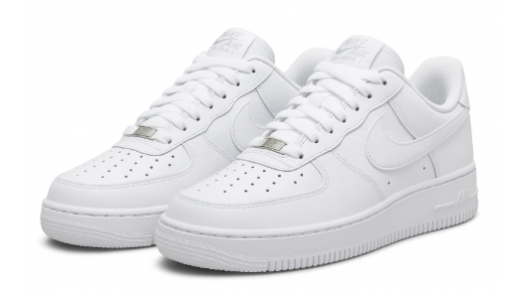

Nike Air Force 1 Sneakers
These sneakers were first released in 1982.
They are made from premium leather.
The design was created in the United States.

Slide 4
Group Production Task
Create 4–5 sentences about (the sneakers) using:
Passive voice
Impersonal structures (It is said/believed/known...)
Topics: materials, design, popularity, manufacturing,
its evolution, popularity, prodctivity

