Slide 1
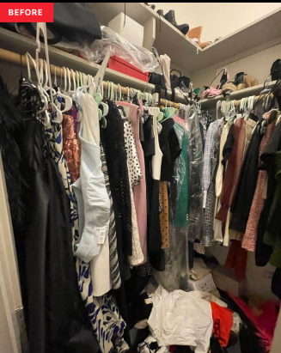
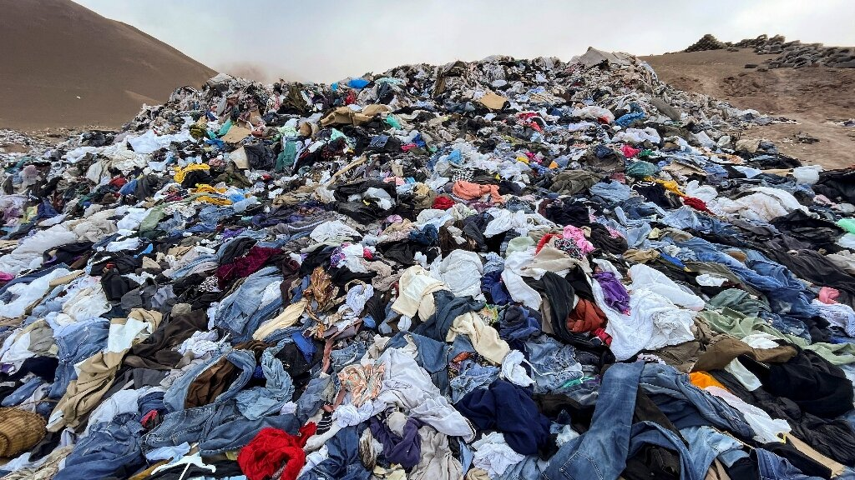
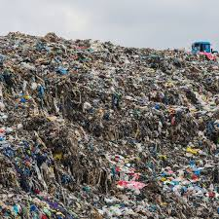
The Environmental Cost of Fast Fashion
Why cheap clothes are expensive for the planet?

Slide 2
What Is Fast Fashion?
Cheap, trendy clothes produced very quickly
  New collections released many times a year
  Designed to be worn for a short time
  Encourages customers to buy frequently
What is the outcome?
Cheaper clothes, but lower quality!!!

Slide 3
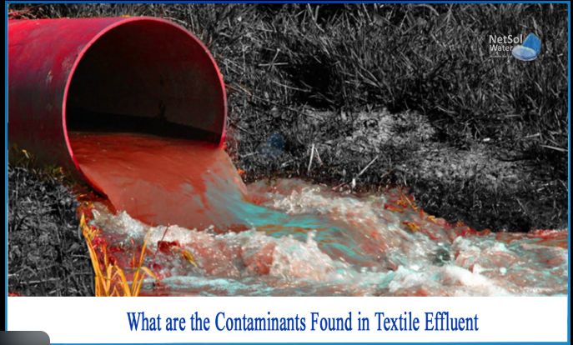
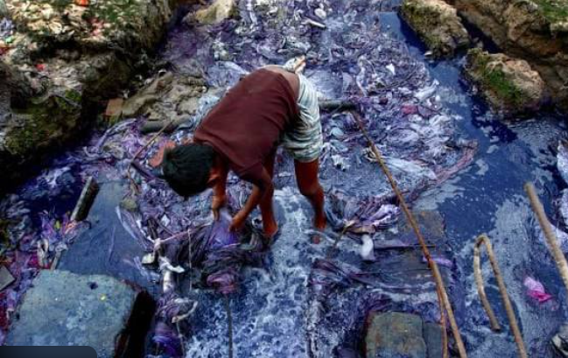
Water Pollution
Textile dyeing uses large amounts of water
  Factories release toxic chemicals into rivers
  Harms wildlife and local communities
  Major source of industrial water pollution
Fashion production pollutes water systems around the world.

Slide 4
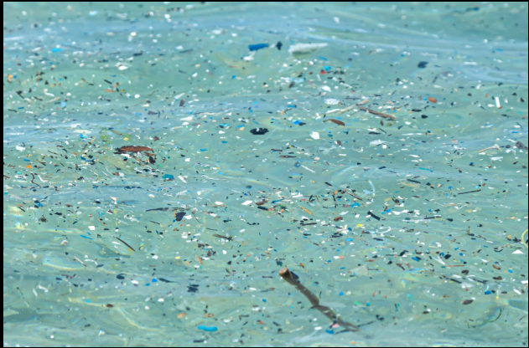
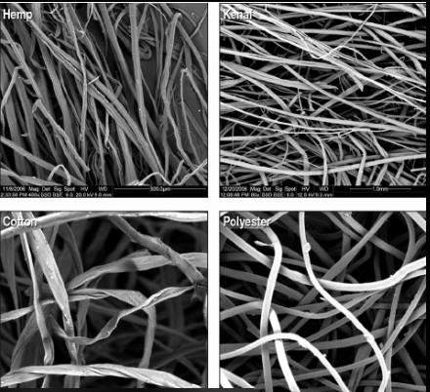
Dangerous Chemicals
Clothes treated with toxic substances
  Some chemicals cause cancer or hormone problems
  Chemicals remain in the environment
  Can enter the food chain
The environmental damage continues even after production.

Slide 5
Microplastics & Polyester
Polyester is made from plastic (petroleum)
  Washing releases microfibres into water
  Microplastics enter oceans
  They do not biodegrade

Slide 6
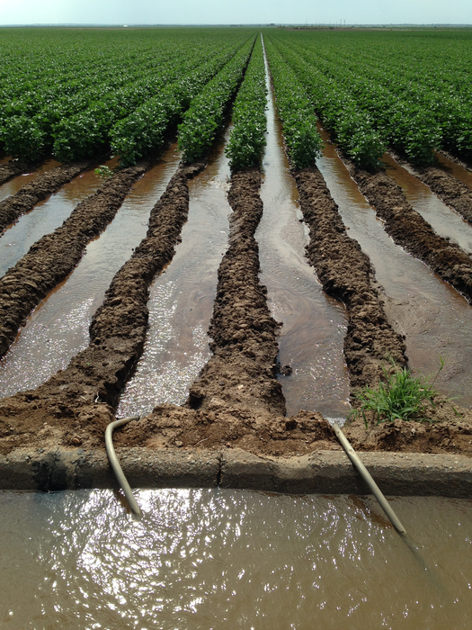

Cotton and Water Use
Cotton farming requires huge amounts of water
  Uses pesticides and chemicals
  Damages soil and drinking water
  Even organic cotton needs water
Natural materials not always environmentally friendly

Slide 7
Clothing Waste
Clothes are often worn only a few times
  Millions of tonnes end up in landfills
  Textile recycling rates are low
  Overproduction increases waste
We are producing more clothes than the planet can handle.

Slide 8
Climate Change
Fashion industry produces greenhouse gases
  Production and transport increase emissions
  Synthetic fabrics come from fossil fuels
Fast fashion contributes to global warming.

Slide 9
What Can We Do?
As consumers:
Buy fewer, better-quality clothes
Repair and reuse items
Buy second-hand
Support sustainable brands

Slide 10
What Can We Do?
As companies:
Use cleaner production methods
Reduce toxic chemicals.
Improve recycling systems.

Slide 11
Conclusion
Fast fashion is convenient but harmful
  Causes pollution, waste, and climate change
  The real cost is paid by the planet

