Slide 1

ΣΥΜΒΟΥΛΙΟ ΤΗΣ ΕΥΡΩΠΗΣ
May 5, 1949 — The Council of Europe is founded. Ten Western European countries establish the Council of Europe to promote democracy and protect human rights and the rule of law. The European Convention on Human Rights enters into force on September 3, 1953.

Slide 2
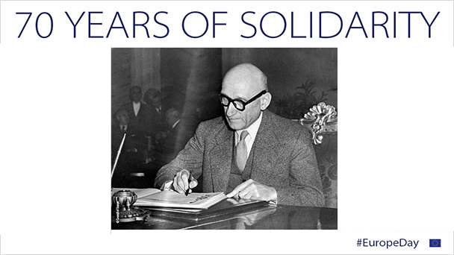
Schuman Plan
May 9, 1950 — Plan for new political cooperation in Europe. French Foreign Minister Robert Schuman presents a plan for deeper cooperation. He proposes integrating the coal and steel industries of Western Europe. Later, May 9 is designated by the European Union as "Europe Day."

Slide 3
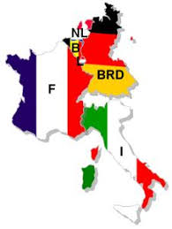
European Coal and Steel Community
18 April 1951 — European Coal and Steel Community. Based on the Schuman Plan, six countries signed a treaty for the joint management of the coal and steel industries. In this way, no single country could manufacture weapons of war and turn against the others, as had happened in the past. These six countries were Germany, France, Italy, the Netherlands, Belgium, and Luxembourg. The European Coal and Steel Community was established in 1952.

Slide 4
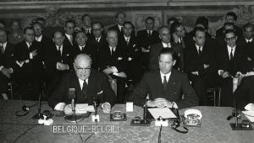
Treaties of Rome
25 March 1957 — Treaties of Rome. Building on the success of the Coal and Steel Treaty, the six founding countries extended their cooperation to other economic sectors. They formalized this cooperation by signing two treaties establishing the European Economic Community (EEC) and the European Atomic Energy Community (Euratom). The two Communities were established on 1 January 1958.

Slide 5
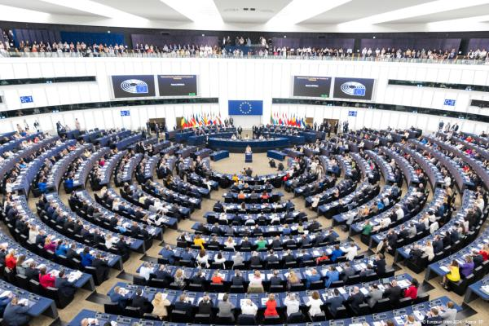
EUROPEAN PARLIAMENT
19 March 1958 — Birth of the European Parliament
The first session of the European Parliamentary Assembly—the precursor to today's European Parliament—took place in Strasbourg, France, with Robert Schuman elected as its President. It replaced the Common Assembly of the European Coal and Steel Community and was renamed the European Parliament on 30 March 1962.

