Slide 1
European language day
UNITED KINGDOM
WALES

Slide 2
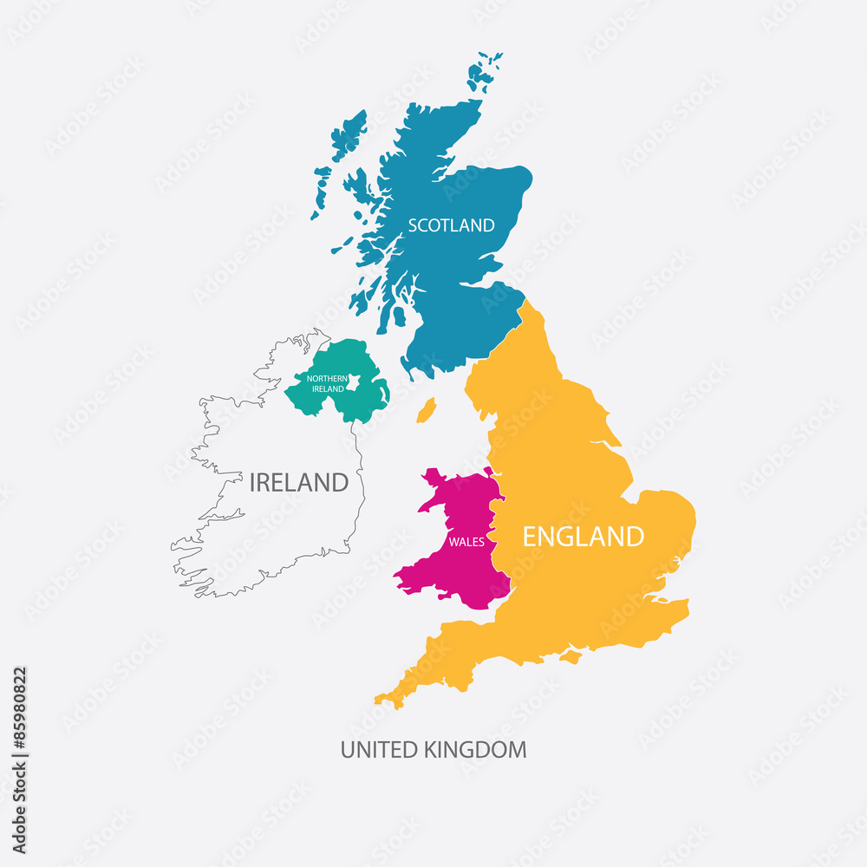
UNITED KINGDOM

Slide 3
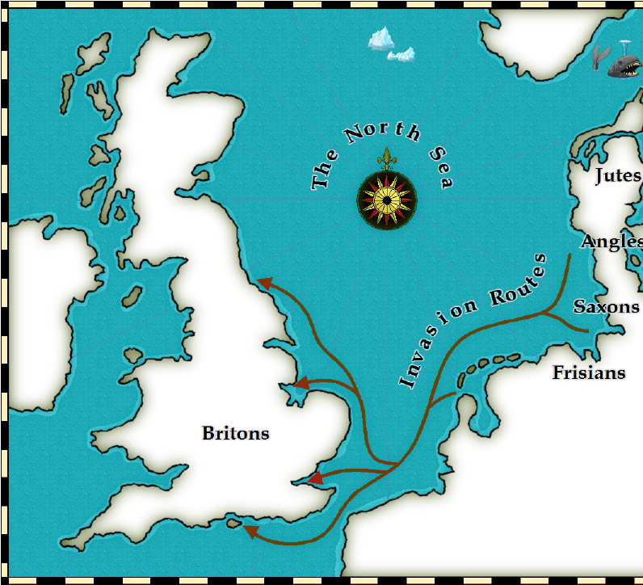
ANGLOSAXON INVASION OF BRITAIN
The Saxons were a tribe of Germanic people who originally came from the area of current northern Germany. They invaded Britain during the time of Roman occupation. Similarly the Angles came from the area of northern Germany and Denmark. Their invasion transformed the language and culture of the area from roman-celtic to germanic.

Slide 4
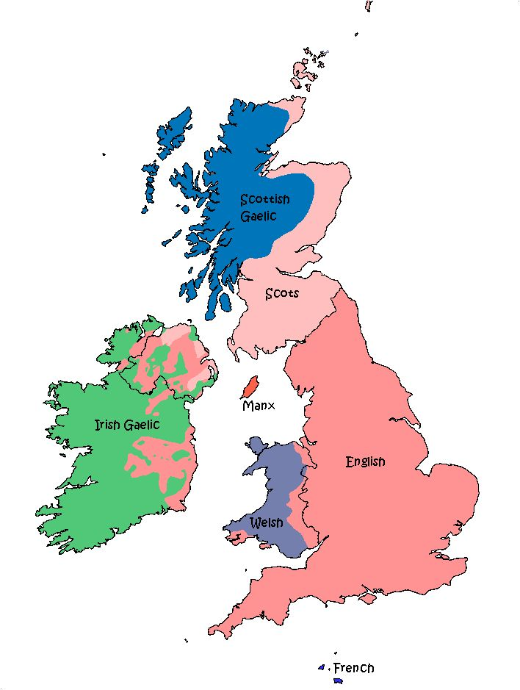
UNITED KINGDOM LANGUAGES

Slide 5
Celtic language
The Celtic languages (/ˈkɛltɪk/ KEL-tik) are a branch of the Indo-European language family, descended from Proto-Celtic.
During the first millennium BC, Celtic languages were spoken across much of Europe and central Anatolia. Today, they are restricted to the northwestern fringe of Europe and a few diaspora communities.
There are six living languages: the four continuously living languages Breton, Irish, Scottish Gaelic and Welsh, and the two revived languages Cornish and Manx. All are minority languages in their respective countries, though there are continuing efforts at revitalisation.

Slide 6
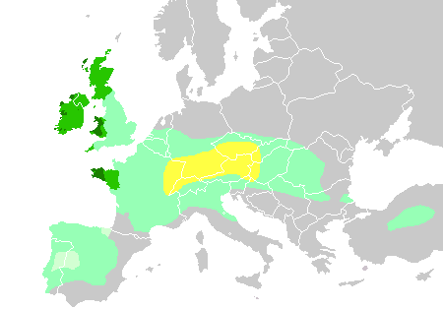
Distribution of Celtic speakers:
Hallstatt culture area, 6th century BC
Maximal Celtic expansion, c. 275 BC
Lusitanian area; Celtic affiliation unclear
Areas where Celtic languages were spoken in the Middle Ages
Areas where Celtic languages remain widely spoken today

Slide 7
Language | Native name | Grouping | Number of native speakers | Number of skilled speakers | Area of origin (still spoken)
Irish | Gaeilge / Gaedhilg / Gaelainn / Gaeilig / Gaeilic | Goidelic | 40,000–80,000 In the Republic of Ireland, 73,803 people use Irish daily outside the education system. | Total speakers: 1,887,437 Republic of Ireland: 1,774,437 United Kingdom: 95,000 United States: 18,000 | Gaeltacht of Ireland
Welsh | Cymraeg / Y Gymraeg | Brittonic | 562,000 (19.0% of the population of Wales) claim that they "can speak Welsh" (2011) | Total speakers: ≈ 947,700 (2011) Wales: 788,000 speakers (26.7% of the population) England: 150,000 Chubut Province, Argentina: 5,000 United States: 2,500 Canada: 2,200 | Wales

Slide 8
Language | Native name | Grouping | Number of native speakers | Number of skilled speakers | Area of origin (still spoken)
Scottish Gaelic | Gàidhlig | Goidelic | 57,375 (2011)^{[29]} | Scotland: 87,056 (2011)^{[29]} Nova Scotia, Canada: 1,275 (2011)^{[30]} | Scotland
Cornish | Kernowek / Kernewek | Brittonic | 563^{[33][34]} | 2,000^{[35]} | Cornwall
Manx | Gaelg / Gailck | Goidelic | 100+,^{[8][37]} including a small number of children who are new native speakers^{[38]} | 1,823^{[39]} | Isle of Man

Slide 9
WELSH LANGUAGE

Slide 10
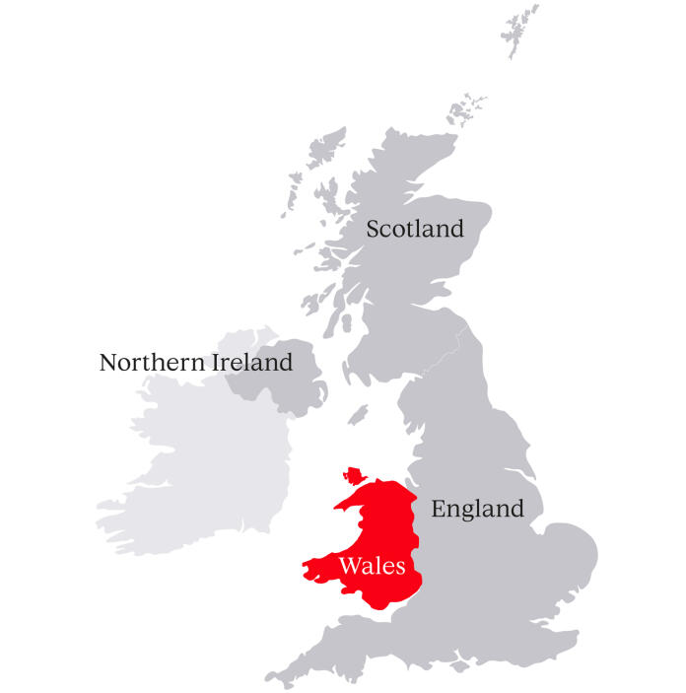
WALES

Slide 11
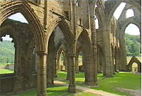
A BRIEF HISTORY OF WALES

Slide 12
WHEN DID WALES CAME INTO EXISTENCE?
As a country, Wales began with Henry VIII's Act of Union in 1536. Before that time Wales had been a loose collection of independent kingdoms and lordships with influxes and incursions from Europe. It's believed that Wales, as an area of land, has been inhabited since 250,000 BC

Slide 13
WHO ARE THE WELSH?
The Welsh today are descended from many people. Celtic tribes from Europe came to settle the whole of the British isles around 500-100 BC, alongside the original Iron Age population.
It was their language which sowed the seeds of the modern Welsh language. Roman and Saxon invasions pushed the original Britons into the land area of Wales, where they became the Welsh people. Inward and outward migration has added diverse new layers of population across history

Slide 14
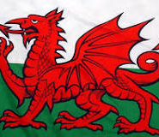
WELSH FLAG

Slide 15
WHERE DOES THE WELSH FLAG COME FROM?
The origins of the Red Dragon flag, or "y Draig Goch", could date back to the Roman period, when the dragon (or draco) was used by Roman military cohorts at the time of the Emperor Trajan. After the Romans left, the Red Dragon remained as a key emblem of Wales and there are accounts of battles against the Saxons under the Red Dragon.
The Tudors adopted the Red Dragon, and the Welsh-born future Henry VII took to the battle of Bosworth Field under the Red Dragon standard.

Slide 16
WHERE DOES THE WORD WALES COME FROM?
The origin of the word Wales is a strange one. It is a variation on a common word used hundreds of years ago by the Anglo Saxons to mean foreigners or outsiders. Variations of the same word can be found in other countries, such as Walloon part of Belgium.
Since this word is one given to the principality by the Anglo-Saxons rather than by ourselves, it could be argued that Cymru (meaning friends/companions) is a preferable one to Wales, although the origins are long enough in the past for us to be equally proud of both names today.
Interestingly, a variation on Cymru can also be found outside Wales, as the name of the northern English county of Cumbria has similar linguistic origins.

Slide 17
According to the 2021 census, the Welsh-speaking population of Wales aged three or older was 538,300 (17.8%) and nearly three quarters of the population in Wales said they had no Welsh language skills. Other estimates suggest that 862,700 people (28.0%) aged three or older in Wales could speak Welsh in March 2024. Almost half of all Welsh speakers consider themselves fluent, while 20 per cent are able to speak a fair amount. 56 per cent of Welsh speakers speak the language daily, and 19 per cent speak the language weekly.

Slide 18
The Welsh government plans to increase the number of Welsh-language speakers to one million by 2050. Since 1980, the number of children attending Welsh-medium schools has increased, while the number going to Welsh bilingual and dual-medium schools has decreased.Welsh is considered the least endangered Celtic language by UNESCO

Slide 19
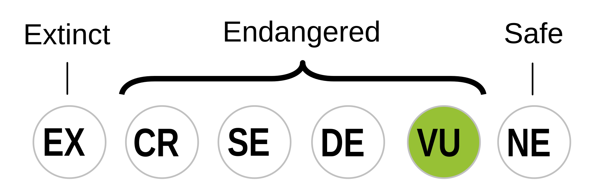
WELSH

Slide 20
WELSH
If Welsh can seem complex and beautiful, it’s because it’s spent 4,000 years evolving. What’s certain is that it’s Britain’s oldest language. From Indo-European and Brythonic origins, the Romans were the first to commit these words to paper, introducing elements of Latin still present today.

Slide 21
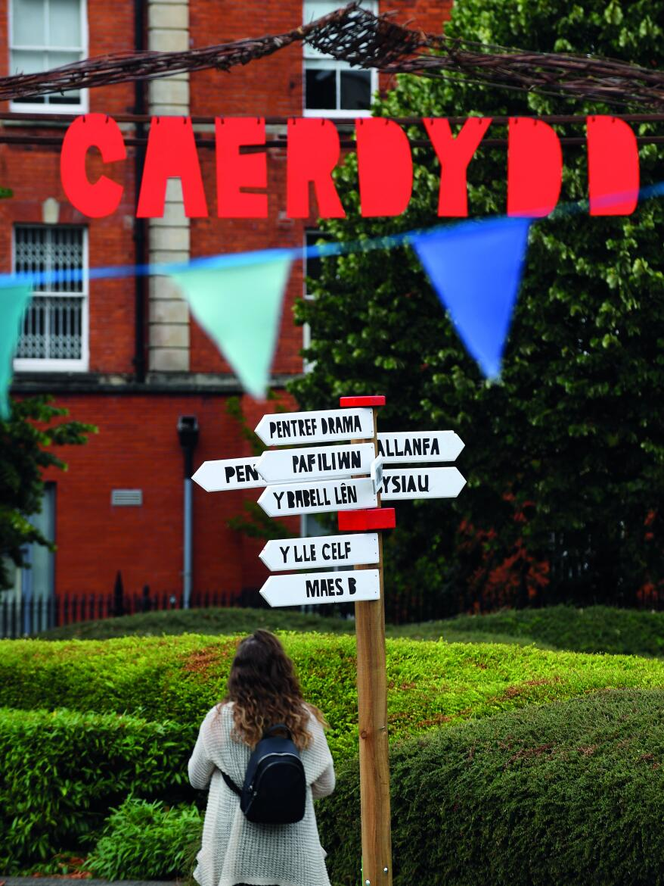

Slide 22
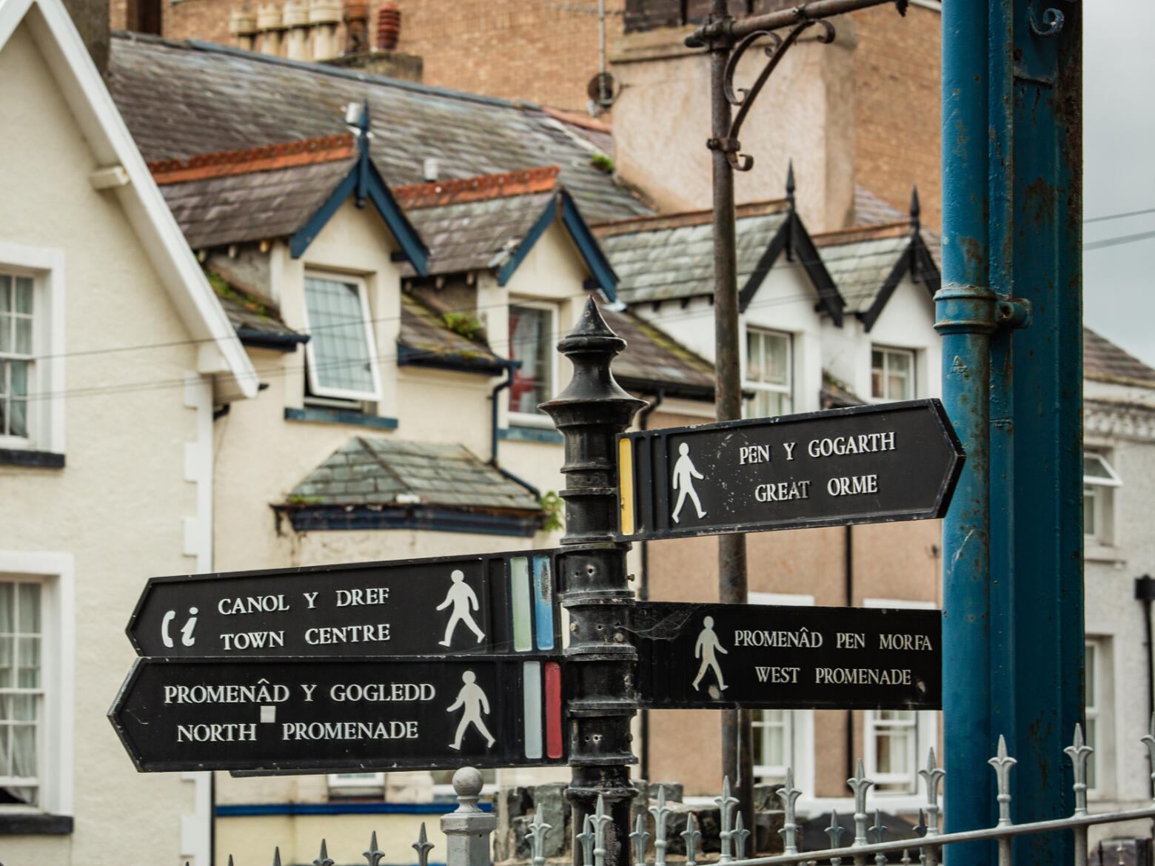

Slide 23
WELSH RADIO
https://www.bbc.co.uk/sounds/play/live:bbc_radio_cymru

Slide 24
EASY WELSH PHRASES
Bore da (Pronounced: Boh-reh dah): Good morning
Prynhawn da (Prin-houn dah): Good afternoon
Nos da (nohs dah): Good night
Croeso i Gymru (Croesoh ee Gum-reeh): Welcome to Wales
Iechyd da! (Yeh-chid dah): Good health! (Cheers!)
Tafarn (Tav-arn): Pub
Diolch (Dee-olch): Thanks
Da iawn (Dah ee-aw-n): Very good

