Slide 1
https://www.youtube.com/watch?v=Ws6HPTom2AY

Slide 2
SCIENCE

Slide 3
NEWTON’S LAWS

Slide 4
NEWTON’S LAWS OF MOTION
Kinetic energy Friction
Inertia Mass
Force Action –reaction
Equal Opposite
Accelerate

Slide 5


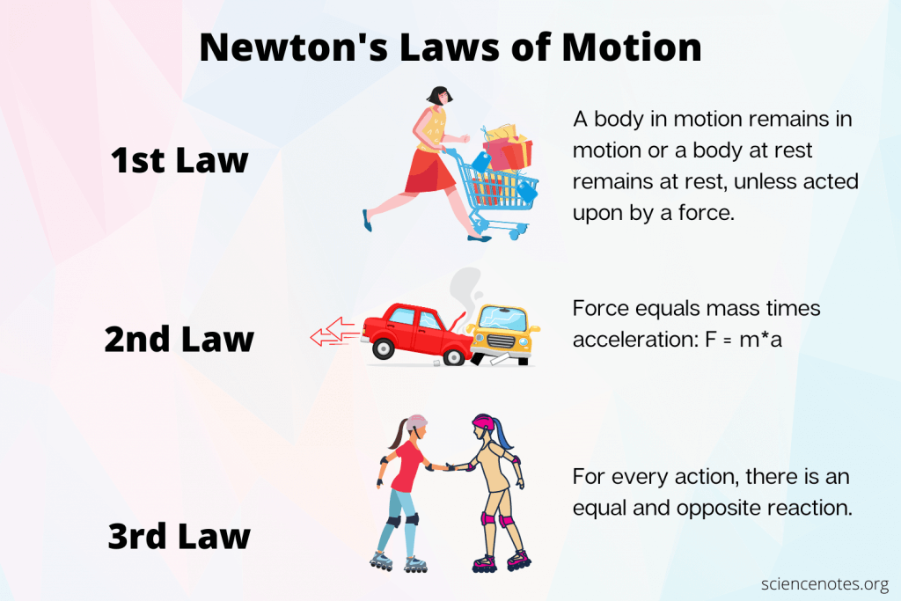

NEWTON’S LAWS OF MOTION
z

Slide 6
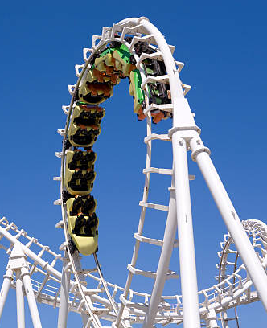
ROLLER COASTER
They don’t have engines, they don’t have brakes so, what makes a roller coaster speed up, slow down and loop upside down?

Slide 7
ROLLER COASTER
They don’t have engines, they don’t have brakes so, what makes a roller coaster speed up, slow down and loop upside down?
KINETIC ENERGY
INERTIA
FRICTION

