Slide 1


Welcome to ESP English
Your Specialized Gateway to Global Success in Health, Agriculture & Information Technology

Slide 2

What is ESP & Why Does It Matter?
Transforming general language skills into specialized, career-ready tools for the modern workplace.

Slide 3


General English vs. ESP English
General English
ESP English
Focuses on everyday conversations, basic grammar rules, and generic vocabulary topics.
Tailored specifically to your vocational field, technical terminology, and professional tasks.
•
Ordering food in a restaurant
•
Reading tech manuals, code, or patient charts
•
Discussing weather and hobbies
•
Operating smart agricultural machinery
•
General high school textbook exercises
•
Communicating with global clients & specialists

Slide 4






3 Pillars of Your ESP Advantage
Career Edge
Technical Mastery
Global Opportunities
Stand out to top employers with practical, specialized communication skills that boost job placement and higher starting salaries.
Gain total confidence reading equipment specifications, user manuals, software documentation, and professional guidelines.
Prepare for European Erasmus+ programs, international certifications, global research, and multinational teamwork.

Slide 5


Health Sector Spotlight
Precision in Patient Care
In healthcare, precise communication saves lives. ESP equips you with the vocabulary to excel in modern medical environments.
•
Medical terminology & anatomy vocabulary
•
Patient triage & empathetic communication
•
Understanding clinical reports & pharmacology
•
Operating digital medical devices in English

Slide 6
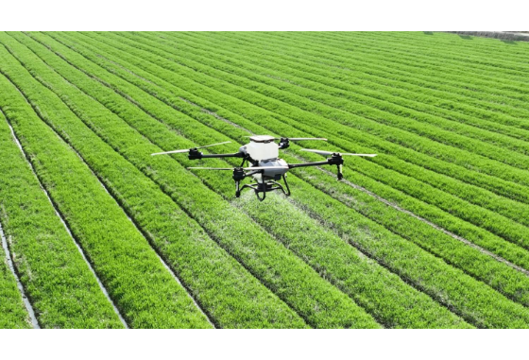
Agricultural Sector Spotlight
Smart Farming & AgTech
Modern agriculture relies on global technology, automated systems, and international export standards.
•
AgTech & precision farming terminology
•
Operating automated irrigation & drone systems
•
EU agricultural regulations & quality standards
•
Sustainable farming & climate tech research

Slide 7

Information Technology Spotlight
The Code of Global Tech
English is the native language of computing, programming frameworks, and global software development.
•
Reading API documentation & tech specs
•
Writing clean code comments & error tickets
•
Cybersecurity protocols & network administration
•
Agile team communication & GitHub workflows

Slide 8

Real Impact of ESP Skills
Why Technical English Matters
85%
Over 85% of scientific research, technical manuals, open-source software code, and medical journals worldwide are published in English.
Mastering specialized English immediately doubles your access to industry knowledge, problem-solving forums, and career opportunities.
Global Technical Data in English

Slide 9
Specialization Overview
Sector | Core Vocabulary | Key Practical Task | Career Destination
Health | Anatomy, Diagnostics, Care | Reading medical charts & patient communication | Nursing, Telehealth, Medical Assistant
Agriculture | Agronomy, Soil, AgTech, Bio | Configuring smart sensors & export specs | Precision Farmer, Agribusiness Specialist
IT | DevOps, Syntax, Networks, UI | Writing documentation & troubleshooting bug reports | Web Developer, Systems Admin, QA Analyst

Slide 10
Our Learning Roadmap
Phase 2: Practice
Simulations, role-plays, and reading technical guides in your field.
Phase 4: Showcase
Specialization capstone project & portfolio presentation.
Phase 1: Discover
Phase 3: Apply
Needs analysis, sector core vocabulary & essential workplace phrases.
Writing workplace emails, reports, and handling authentic scenarios.

Slide 11
Day 1 Activity: Your Profile
Your Career Goals: What is your dream job in Health, Agriculture, or IT?
Your Current Skills: What English topics do you feel confident in, and where do you need help?
Your Particular Interests: What tech, tools, or subjects fascinate you most?
How You Learn Best: Do you prefer videos, group projects, quizzes, or role-plays?

Slide 12

Let's Build Your ESP Future!
Please complete your Student Needs Form to help tailor our course to your dreams.

Slide 13



Image Sources
https://cdn.shopify.com/s/files/1/0078/8715/9367/files/medical_office_furniture.jpg?v=1750317958
Source: effydesk.com
https://framerusercontent.com/images/WuyZbJIN4W7zf2F6xXWXSOg.jpg?width=1500&height=844
Source: www.leher.ag
https://images.stockcake.com/public/8/8/4/884bd5ed-7b2a-423d-87c8-26012cc9bc43_large/coding-workstation-setup-stockcake.jpg
Source: stockcake.com

