Slide 1
Civil Rights

Slide 2
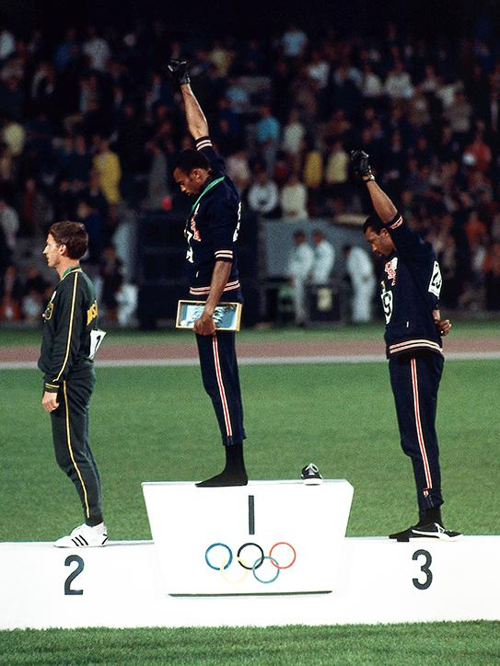
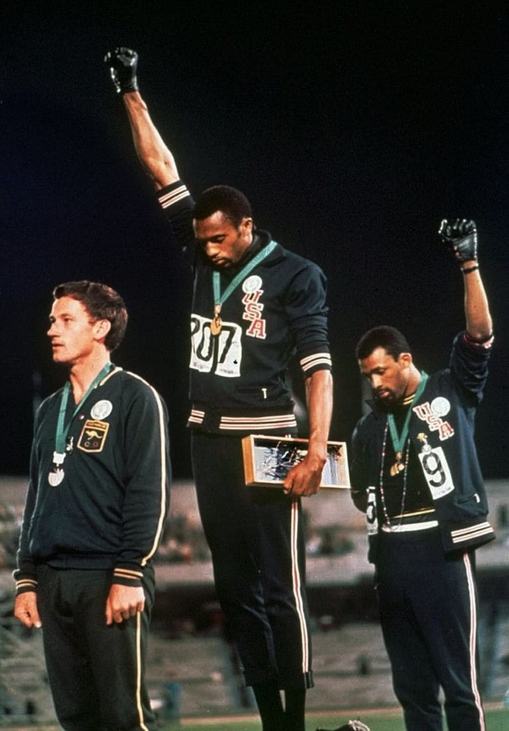

Slide 3
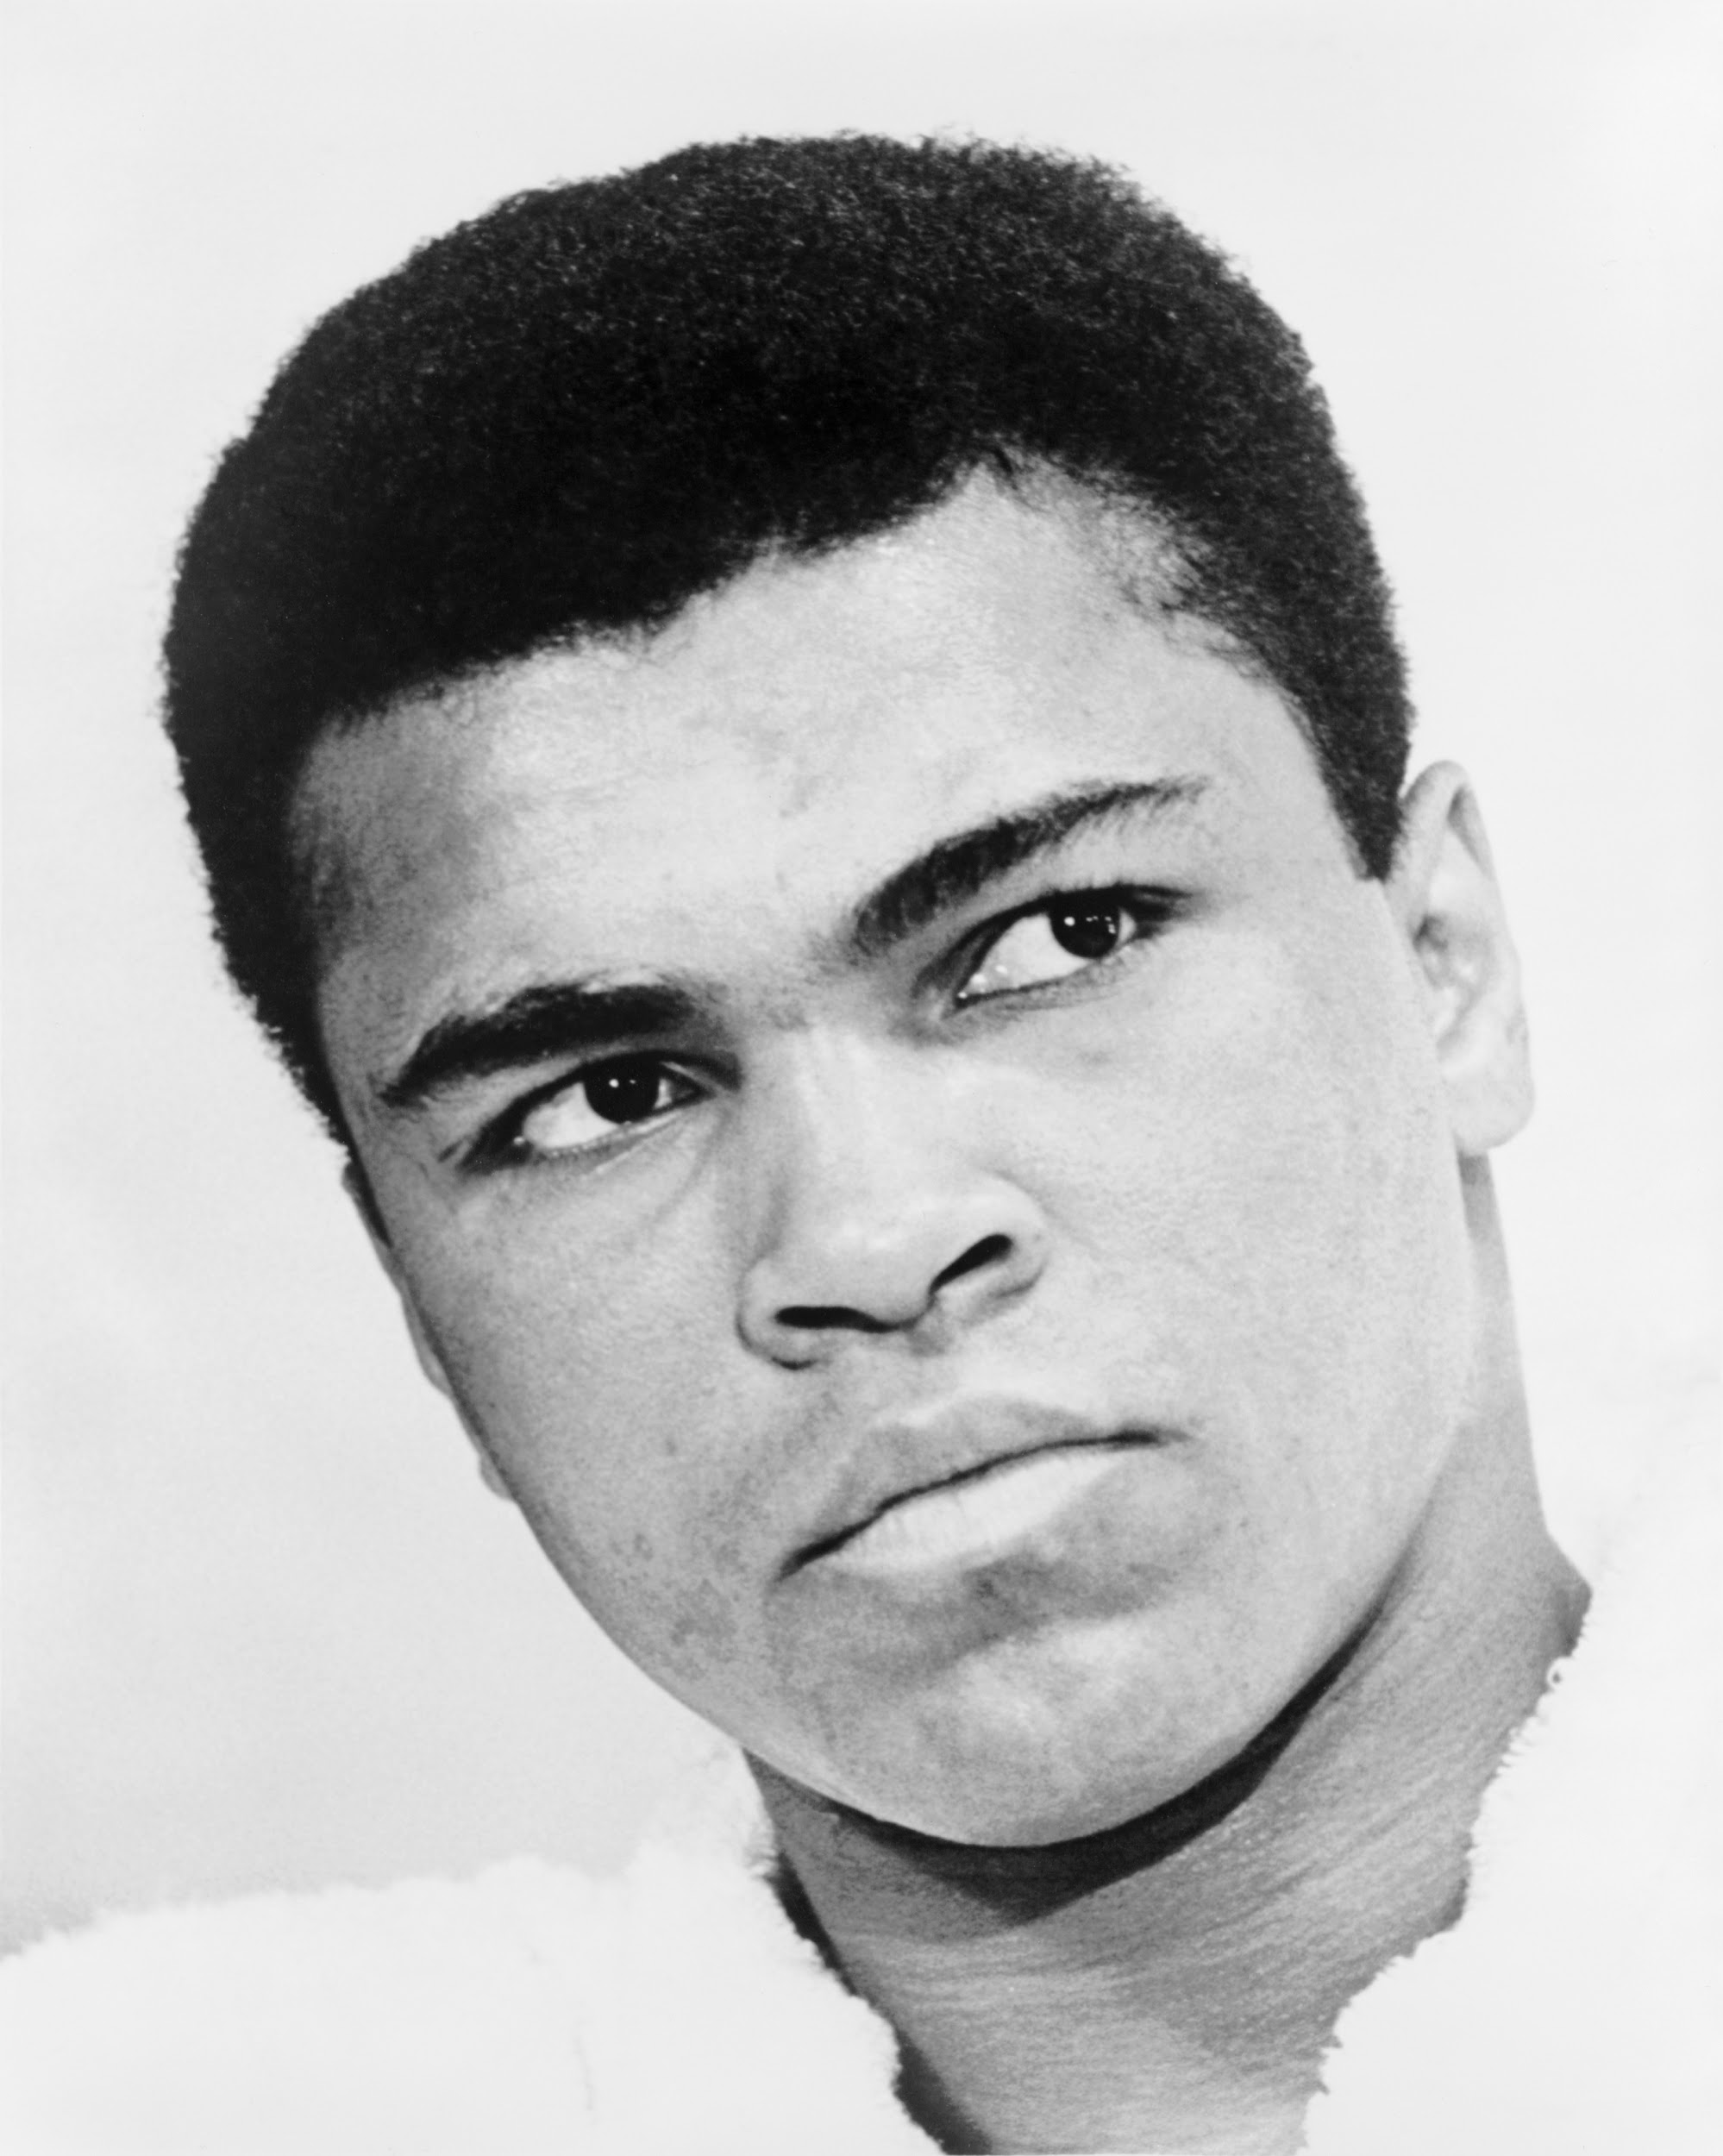
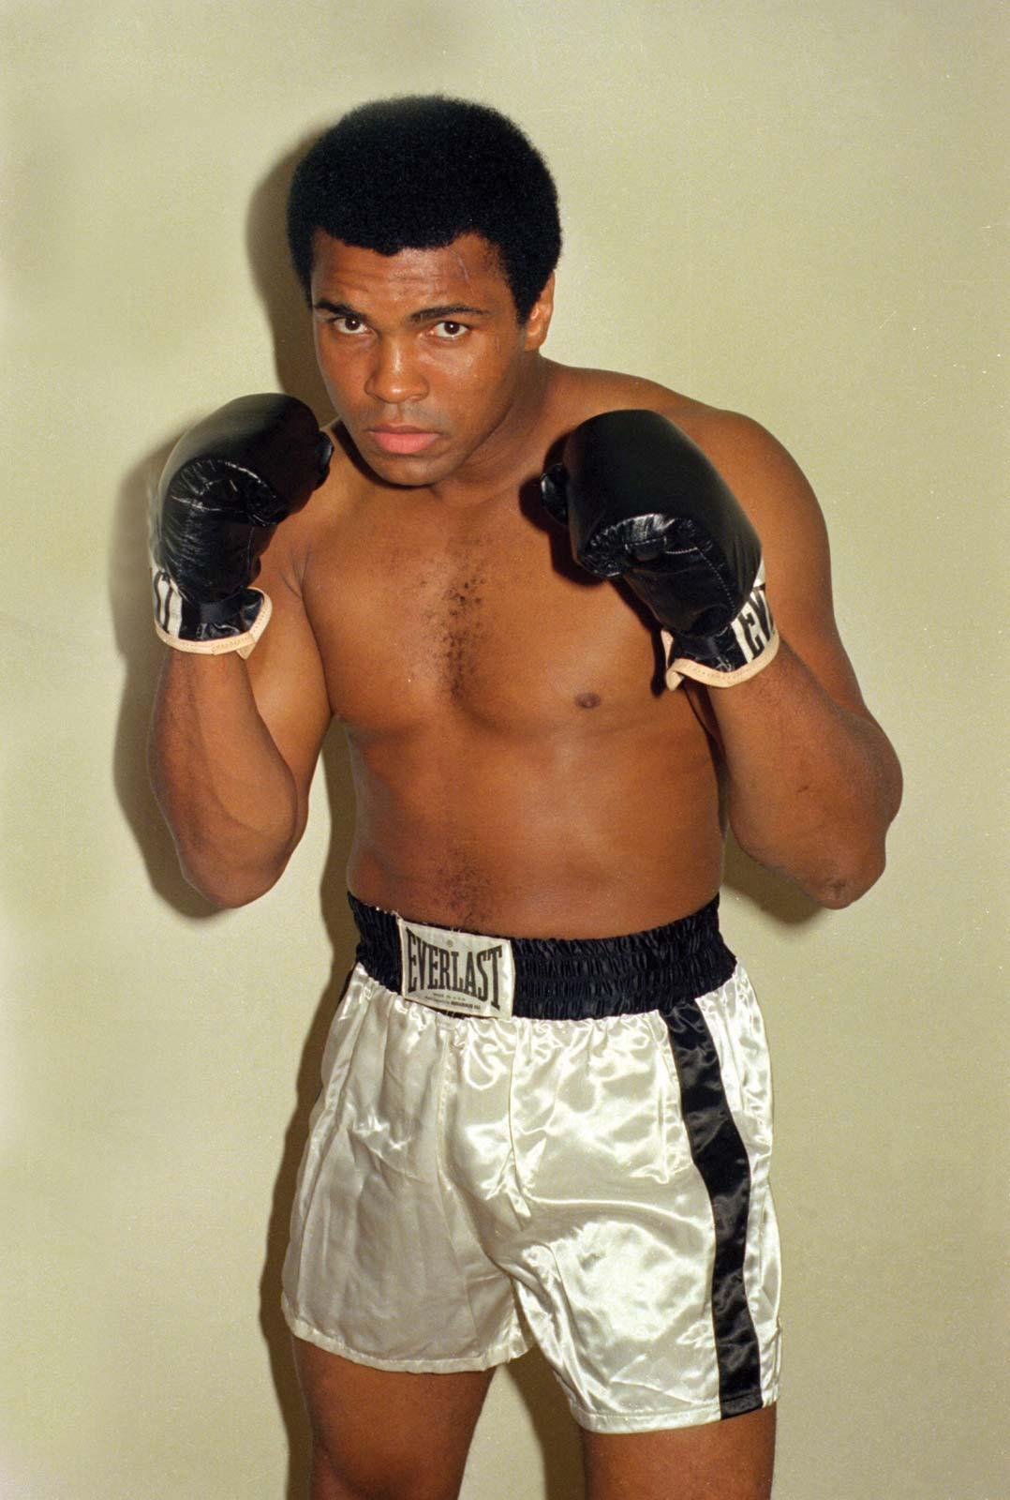

Slide 4
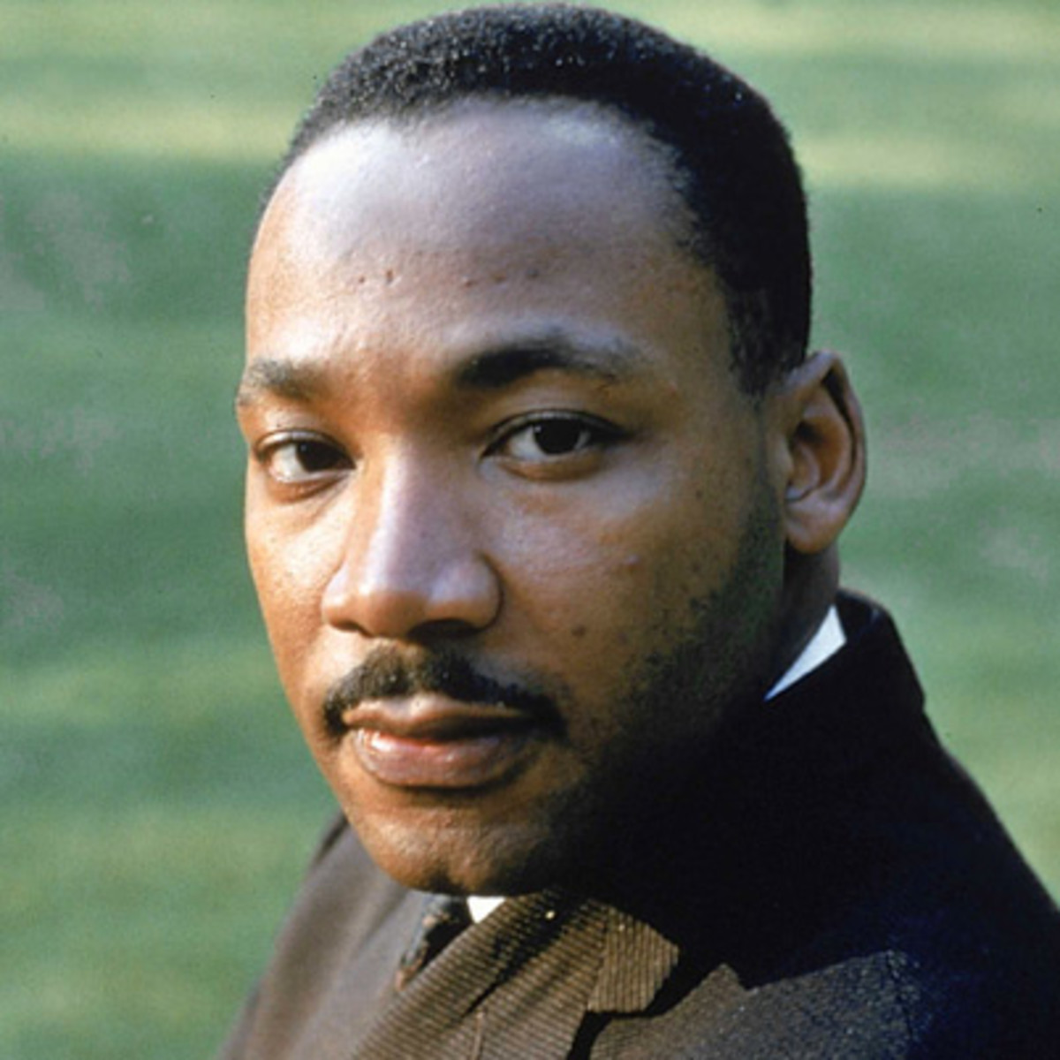
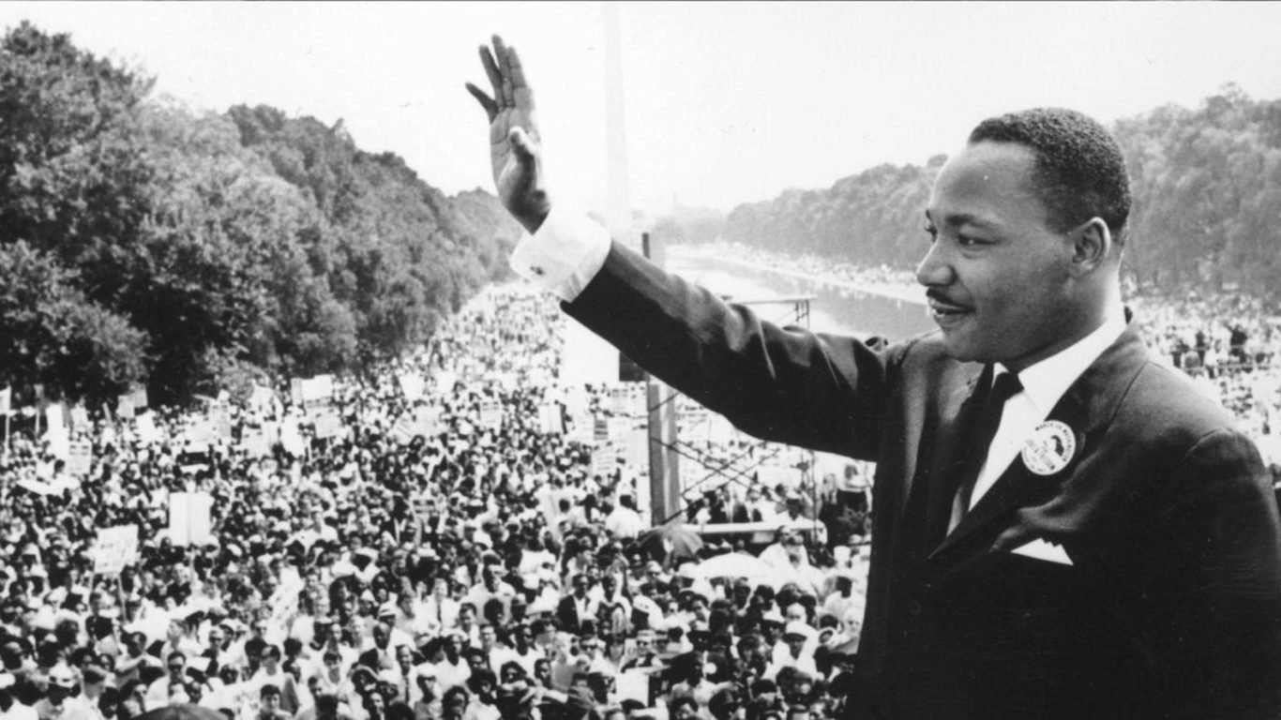

Slide 5
I have a dream that one day this nation will rise up and live out the true meaning of its creed:
"We hold these truths to be self-evident: that all men are created equal." I have a dream that one day on the red hills of Georgia the sons of former slaves and the sons of former slave owners will be able to sit down together at a table of brotherhood.
I have a dream that one day even the state of Mississippi, a desert state, sweltering with the heat of injustice and
oppression, will be transformed into an oasis of freedom and justice.
I have a dream that my four children will one day live in a nation where they will not be judged by the color of their skin but by the content of their character.
I have a dream today.

Slide 6
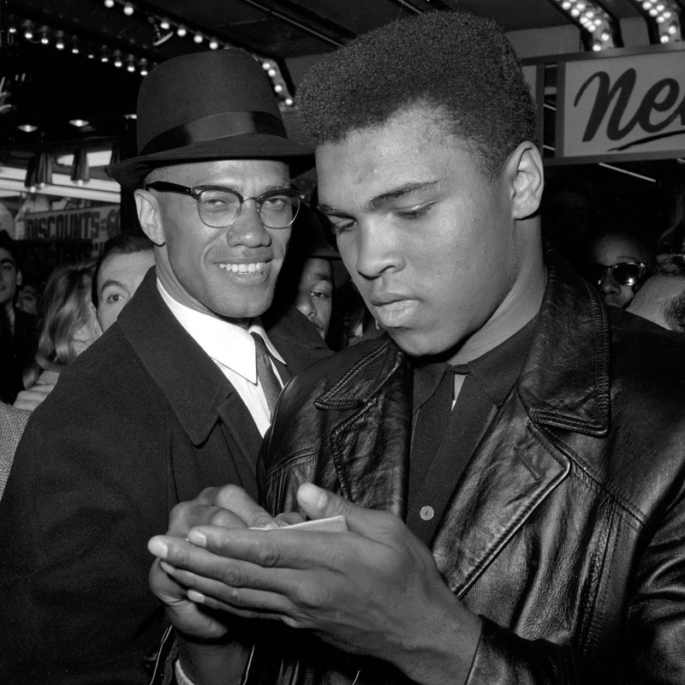
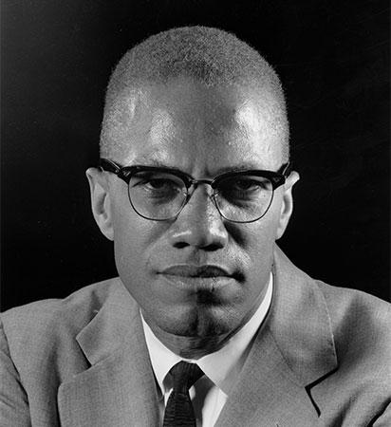

Slide 7
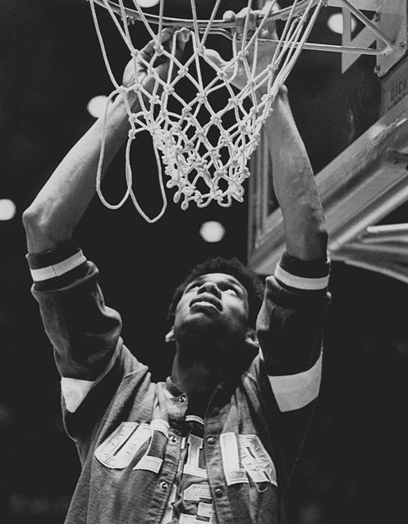
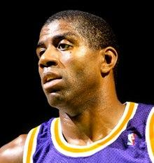

Slide 8
