Slide 1
First conditional

Slide 2
To talk about realistic situations that might happen in the future.
First conditional
e.g.: If it rains today, I’ll stay at home
e.g.: I won’t go to the party if my headache gets worse
If-clause
Can come first or second
Formula
If + present simple + will/won’t + infinitive
If you study hard, you will get good marks

Slide 3
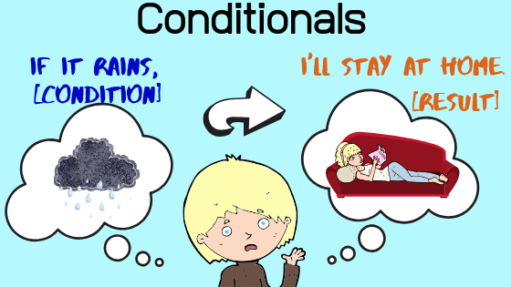
Also
You can use IMPERATIVE or CAN + INFINITVE instead of will + infintive
If you study hard, you will get good marks
If you study hard, you will get good marks
If you study hard, you can get good marks

Slide 4
Zero conditional

Slide 5
Zero conditional
To talk about things that are always or generally true
e.g.: If you don't put sun cream on, you get burnt.
e.g.: If water reaches 100ºC, it boils.
If-clause
Can come first or second
Formula
If + present simple + present simple
If I eat peanuts, I get ill.

Slide 6
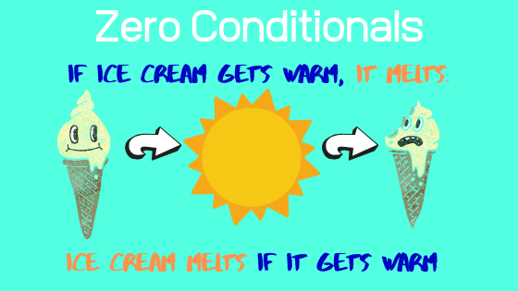

Slide 7
Activity: Match
If I am tired,
I go to the doctor.
If I feel sick,
I eat something.
If you mix blue and red,
they get fat.
If I am hungry,
I go to bed.
If people eat too much,
you get purple.

