Slide 1
A World of Food

Slide 2
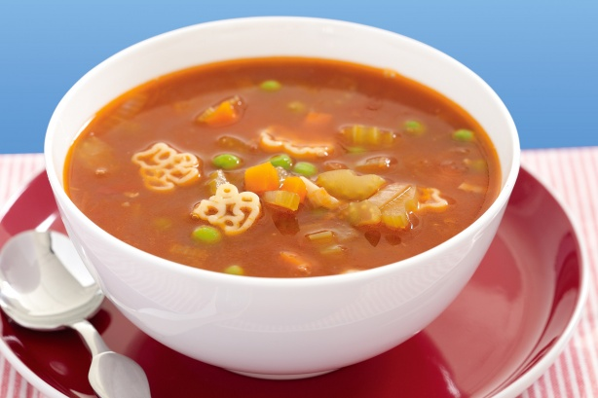
There is a bowl of soup.

Slide 3
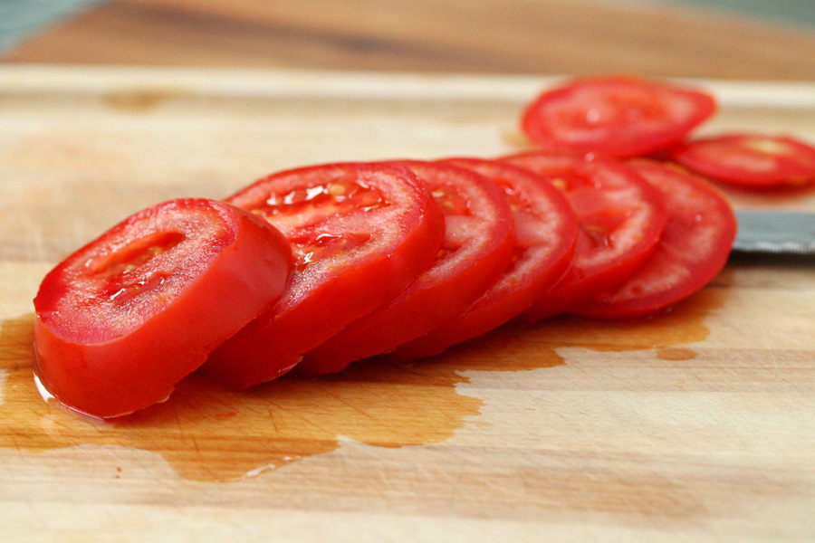
There are eight slices of tomato.

Slide 4
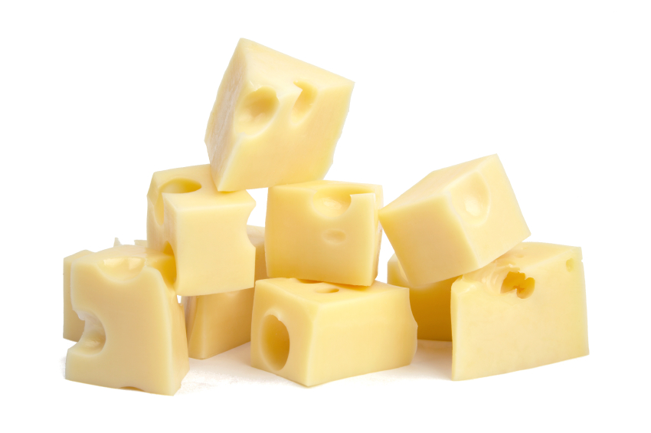
There are eight pieces of cheese.

Slide 5
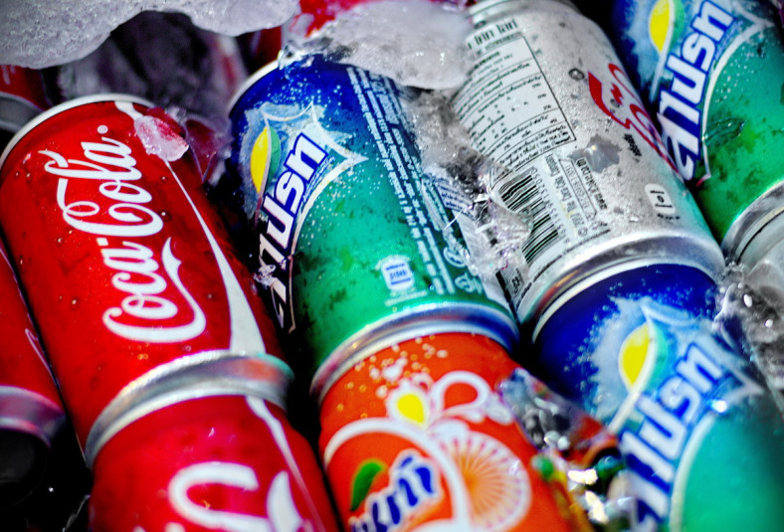
There are cans of soda.

Slide 6
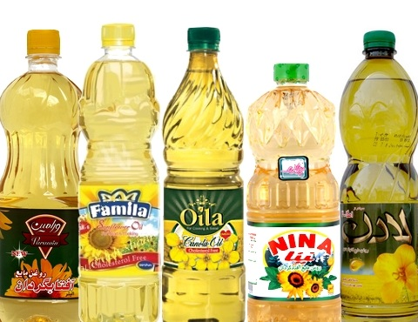
There are five bottles of oil.

Slide 7
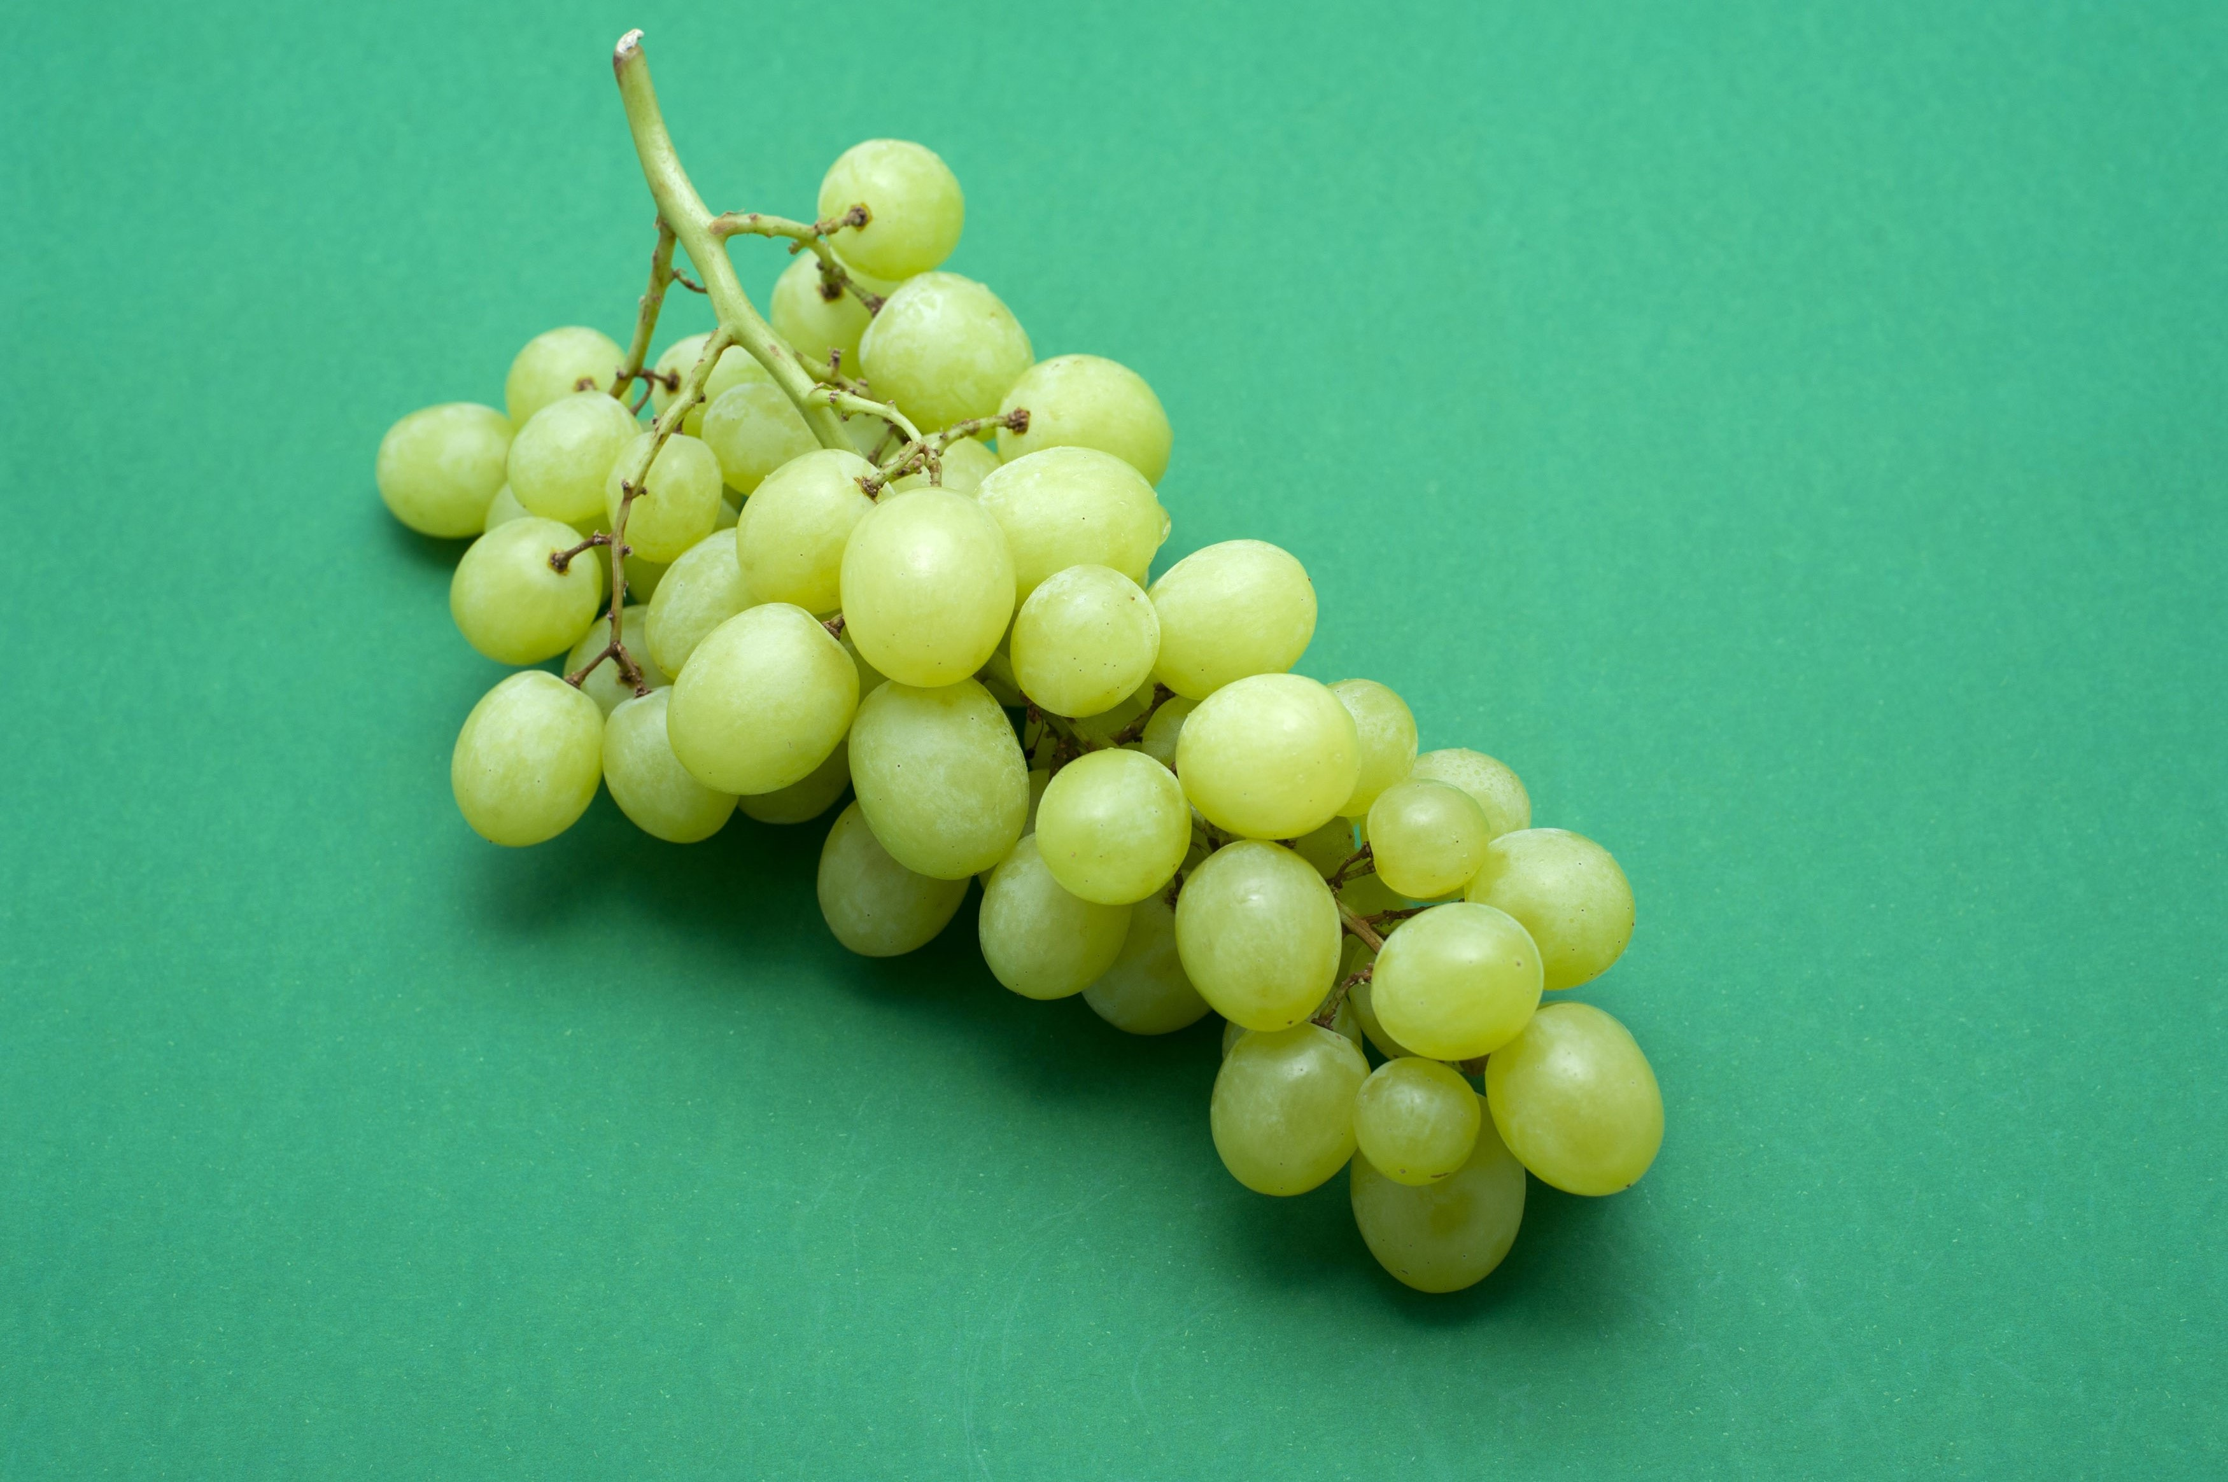
There is a bunch of grapes.

Slide 8
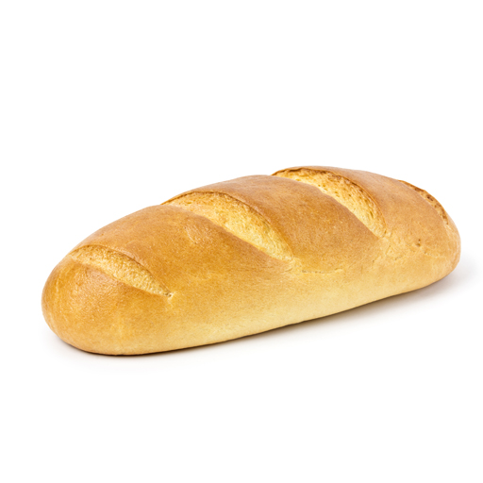
There is a loaf of bread.

Slide 9
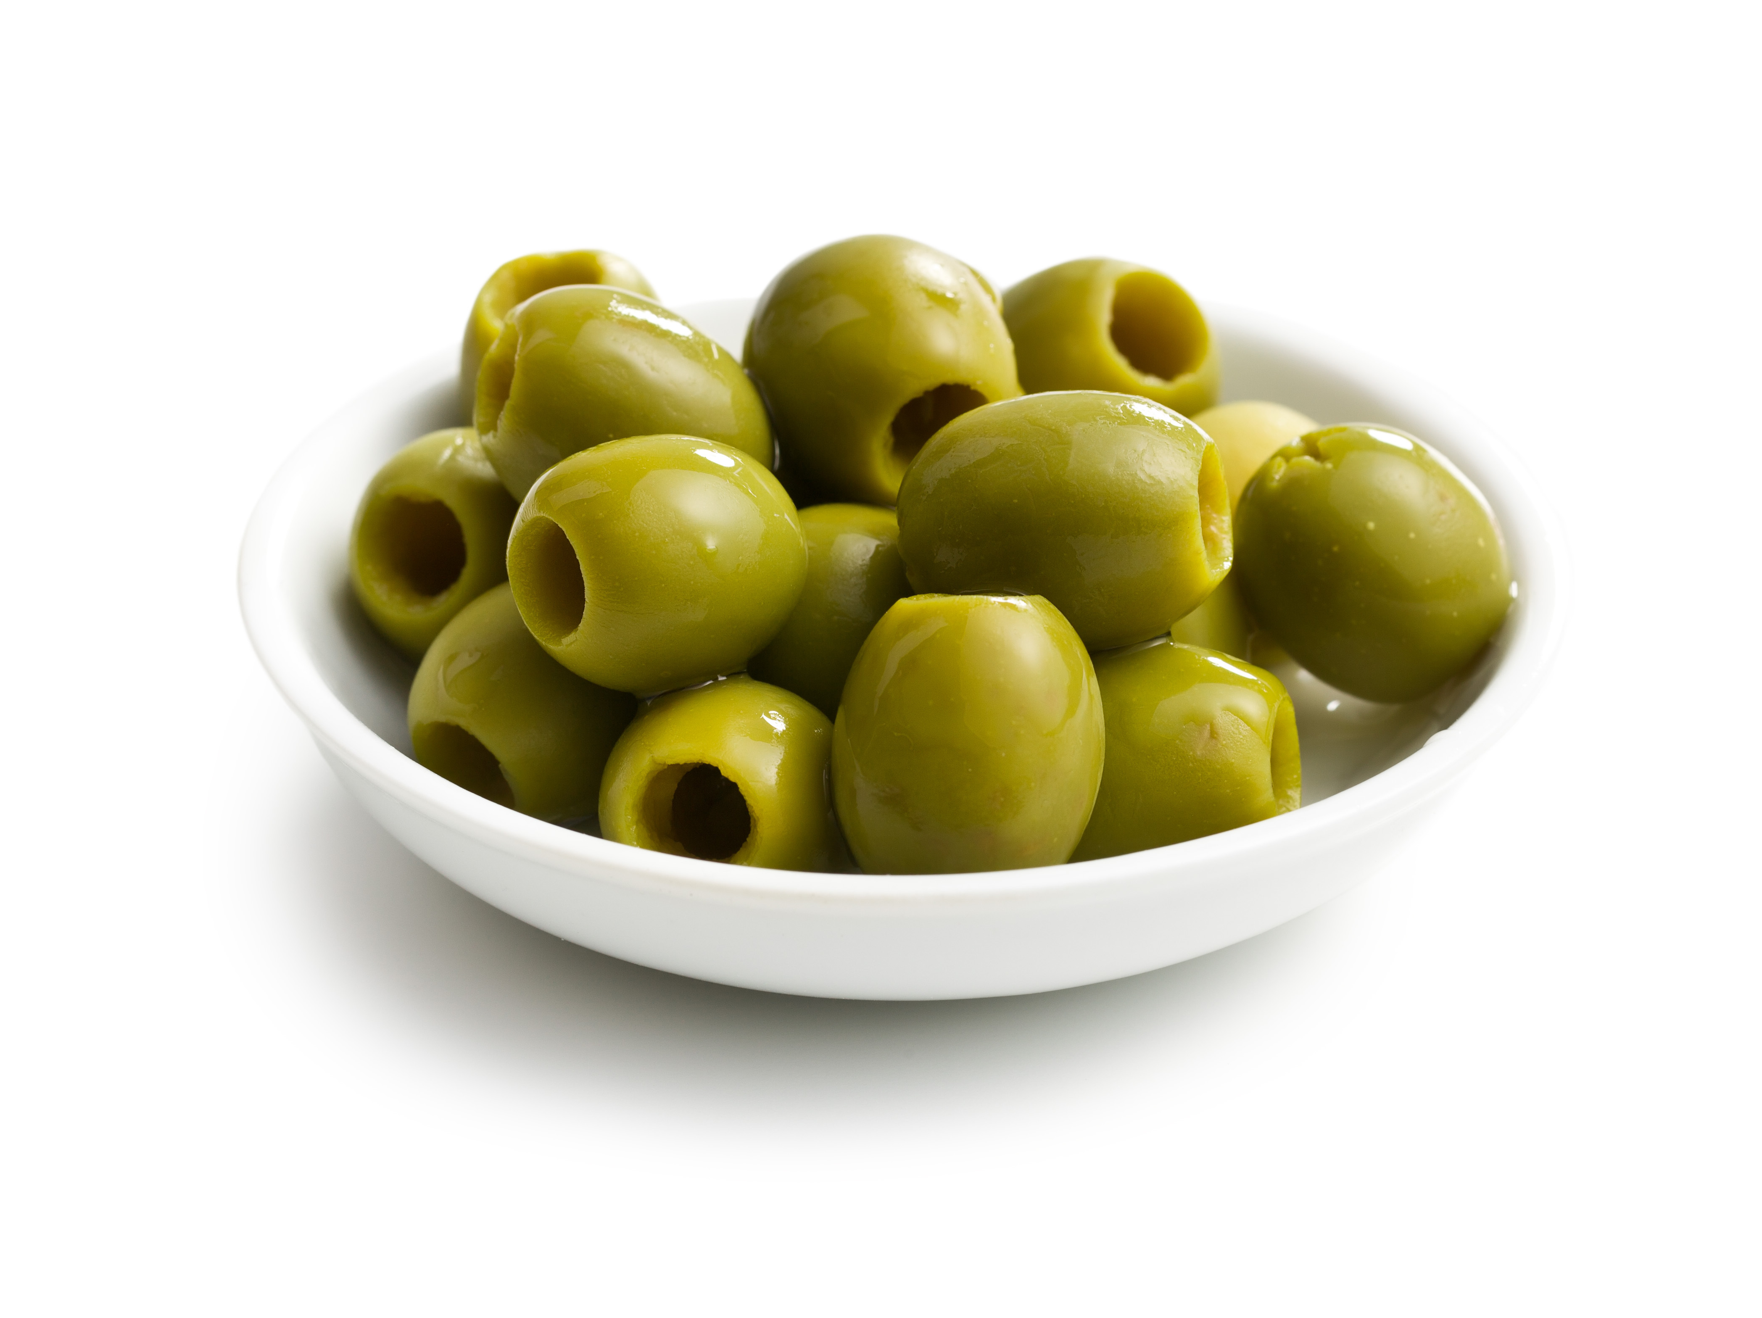
There is a bowl of olives.

Slide 10
Now, Say!

Slide 12

Good Luck!

