Slide 1
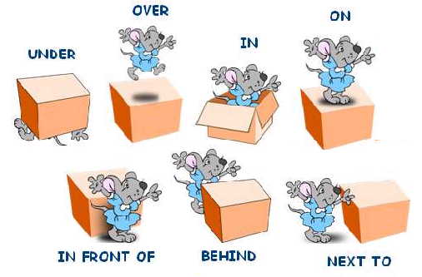
Prepositions of Place

Slide 2
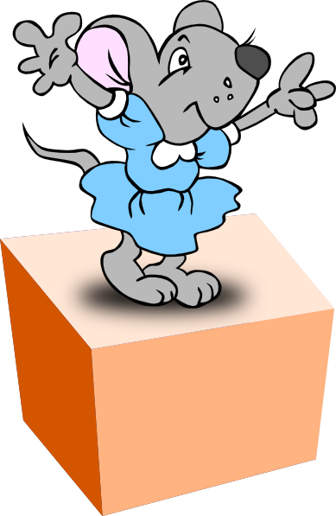
Where’s she?
She’s on the box.

Slide 3
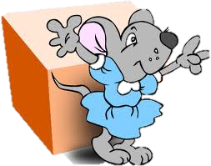
Where’s she?
She’s in front of the box.

Slide 4
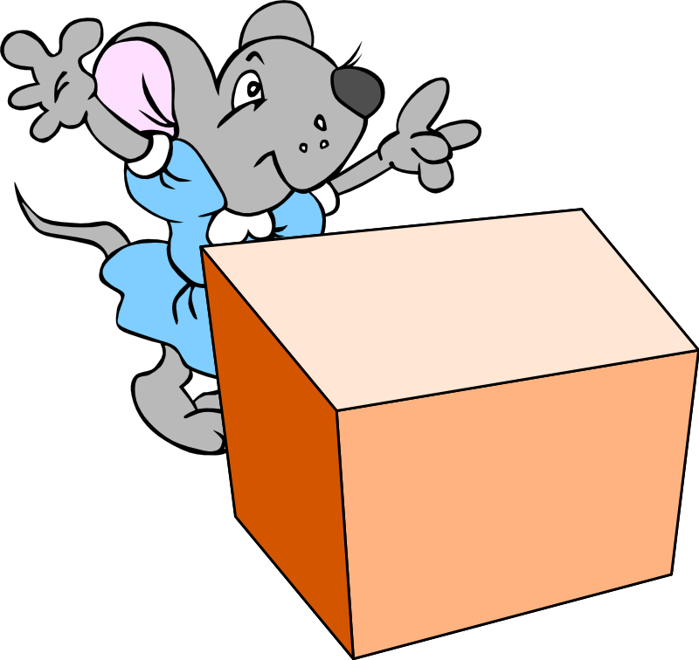
Where’s she?
She’s behind the box.

Slide 5

Where’s she?
She’s next to the box.

Slide 6

Where’s she?
She’s under the box.

Slide 7
Where’s she?
She’s over the box.

Slide 8
Where’s she?
She’s in the box.

Slide 9
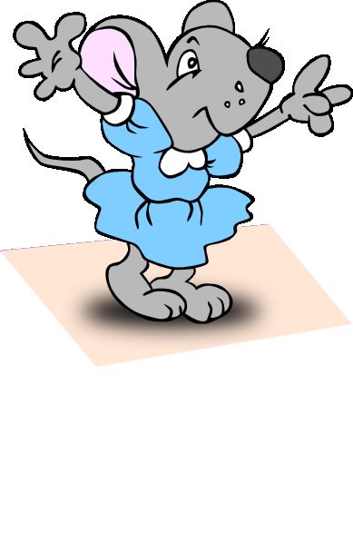
Thank you. ☺

