Slide 1
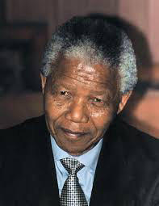
Nelson Mandela
By David, Lucas and Moritz

Slide 2
Agenda
Biography
What did he do
Achivements
Our opinion

Slide 3
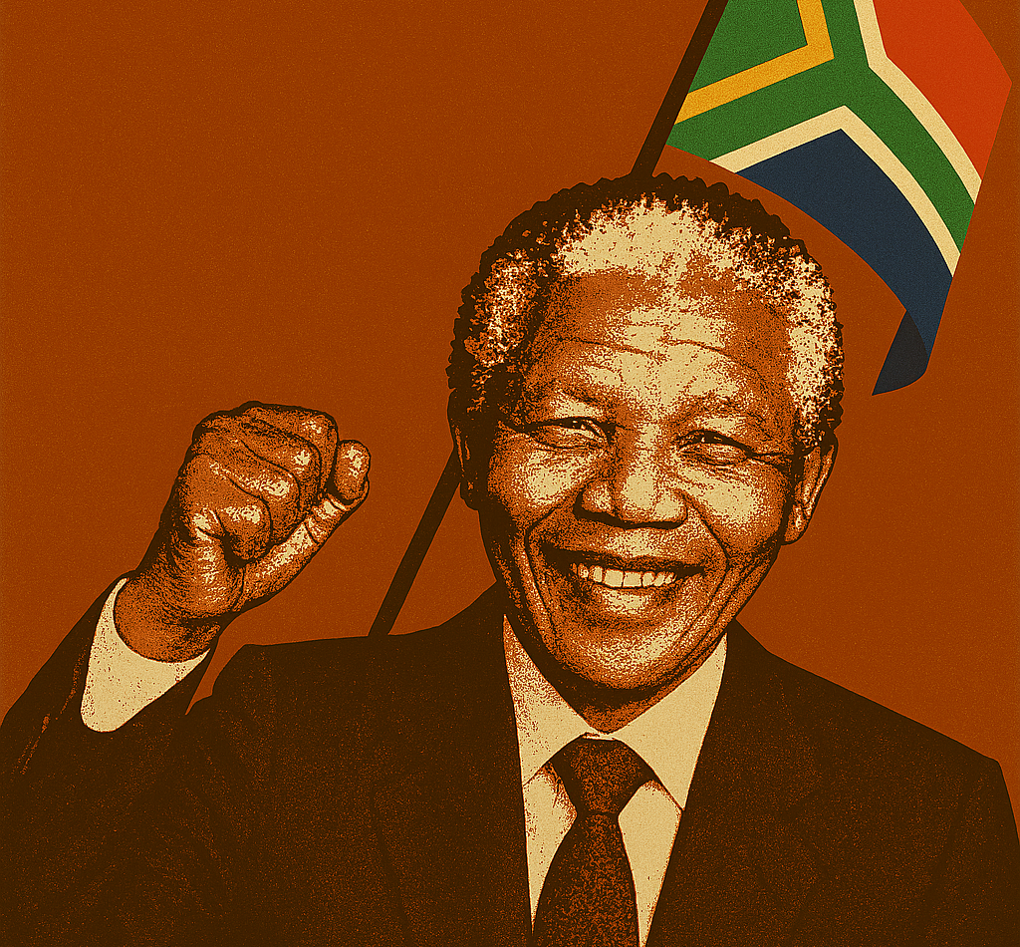
Biography
Born in 1918 in the village of Mvezo South Africa, into a royal family of the Thembu tribe
Studied law and became a lawyer, fighting for equal rights for Black South Africans
Nelson Mandela had six children
He died on December 5, 2013, at the age of 95, in Johannesburg, South Africa

Slide 4

What did he do?
Fought against unfair laws that separated people by race.
Helped start a group to resist apartheid (racial segregation).
Went to prison for 27 years for standing up for equality.
Worked to bring peace between Black and white South Africans.
Spoke around the world for human rights and fairness.

Slide 5
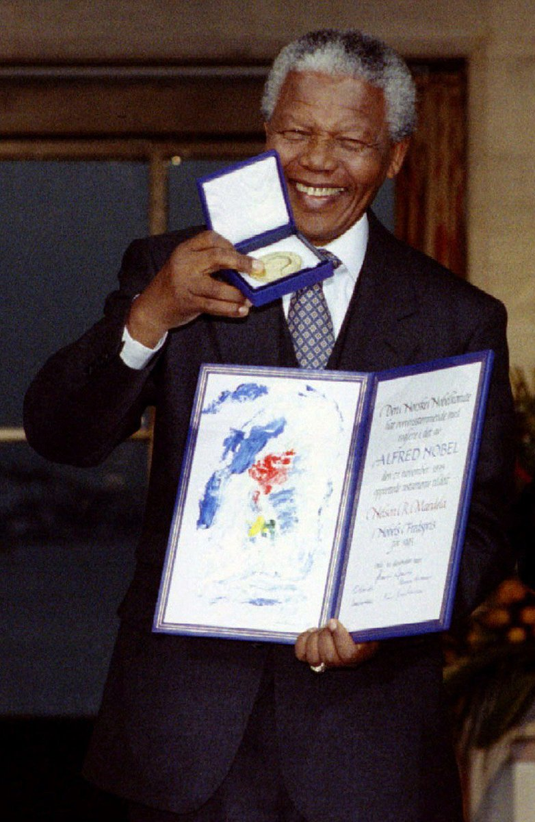
Agenda
Achivements
Anti-apartheid leader who fought against racial segregation in South Africa
First Black president of South Africa (1994–1999), elected after the end of apartheid
Nobel Peace Prize laureate (1993), honored for his role in peacefully transitioning South Africa to democracy
Spent 27 years in prison, becoming a global symbol of resistance and justice
Legacy of reconciliation and equality, inspiring movements against racism worldwide

Slide 6
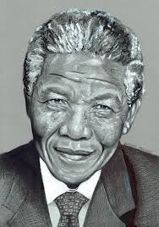
Our opinion
We believe that Nelson Mandela should be a role model for everyone, because despite injustice, he never gave up and succeeded in reducing racism in South Africa and making South Africa a democracy. He was unjustly imprisoned for 27 years and forgave them. Through his achievements, he became known worldwide, which gave many people hope for the future.

Slide 7

The End
Thank you for listening
Do you have any questions

