Slide 1
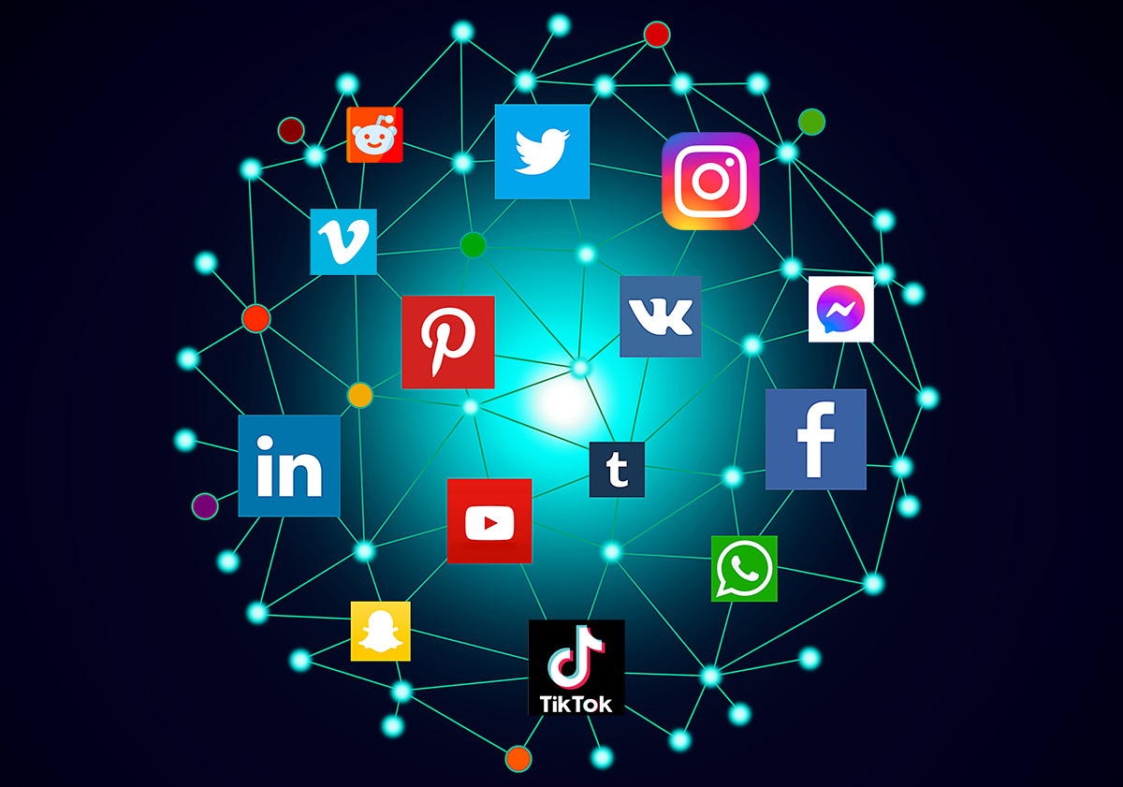
SOCIAL MEDIA
Γεώργιος Κεραμάρης, Νίκος Χαντζής, Γούλας Δημήτρης Α2

Slide 2

DEFINITION
The term social media refers to the means of interaction and communication between groups of people through online communities. Social media is the social interaction between people who create, share or exchange information and ideas within virtual communities and networks.

Slide 3

FACEBOOK
Facebook is a social media platform created by Mark Zuckerberg and his college roommates in 2004. It began as a way for Harvard students to connect but quickly expanded to become a global platform. As of April 2024, Facebook remains the largest social networking platform worldwide, with approximately 3.07 billion active users.

Slide 4
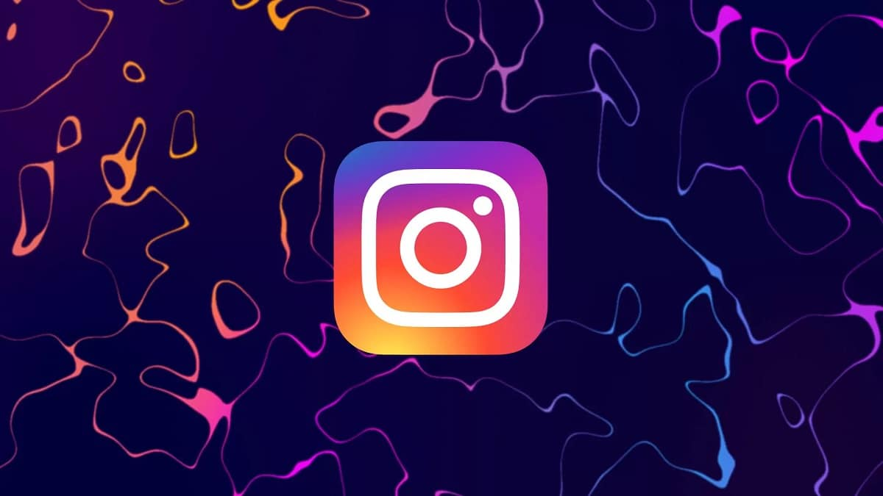
INSTAGRAM
Instagram is famous because it revolutionized the way people share and interact with visual content, offering an easy-to-use platform for publishing aesthetically curated photos and videos, connecting users through features like Stories, Reels, and direct messages, and fostering a global culture of influencers, trends, brand marketing, and social interaction — all focused on lifestyle, creativity, and real-time.

Slide 5

TIKTOK
TikTok is famous for transforming social media with its highly engaging short-form video format, driven by a powerful algorithm that quickly surfaces popular content, allowing users of all backgrounds to go viral, it also provides a great amount of entertainment for every character there is.

Slide 6
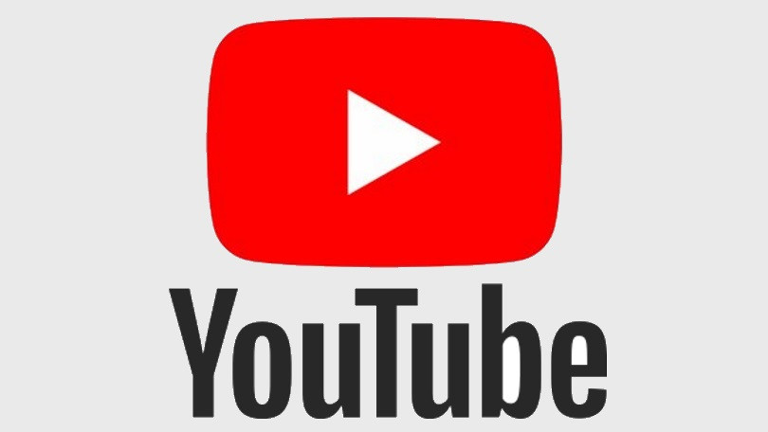
YOUTUBE
YouTube is famous for being the world's largest video-sharing platform where users can upload, watch, and interact with a wide range of content—from tutorials to, music videos and vlogs to educational series, documentaries and live streams—making it a powerful space for entertainment, learning, creativity and community, while also empowering creators to reach a global audience and create personal content. searchable interface.

Slide 7

Thank you for watching, have a lovely day!
Απολογούμαστε για την καθηστέρηση της παράδοσης της παρουσίασής μας.

