Slide 1
Poems about human rights

Slide 2
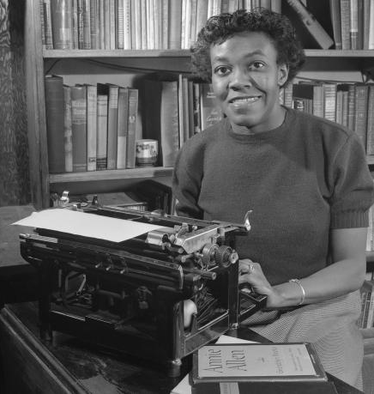
Gwendolyn Brooks

Slide 3
Gwendolyn Brooks
Gwendolyn Brooks is one of the most highly regarded, influential, and widely read poets of 20th-century American poetry. She was a much-honored poet, even in her lifetime, with the distinction of being the first Black author to win the Pulitzer Prize.
Brooks was born in Topeka, Kansas, but her family moved to Chicago when she was young. Her father was a janitor who had hoped to become a doctor and mother was a schoolteacher and classically trained pianist. They were supportive of their daughter’s passion for reading and writing.

Slide 4
We real cool
As for black aesthetic of the civil rights period, Gwendolyn exudes a loud and proud voice to let the black youth of this time period be heard. With her poem “We Real Cool,” published in her book The Bean Eaters, Brooks talks about seven young teens who go out at night to have fun and enjoy life. The political consciousness of this poem is where civil rights is alluded to. The last line of the poem, after speaking of fun times, says, “we die soon,” (8).
“We real cool.
We Left school.
We Lurk late.
We Strike straight.
We Sing sin.
WeThin gin.
We Jazz June.
We Die soon.” (1-8)
The youth being young held a different meaning in 1960 when the peak of the civil rights movement occurred. The last line is very significant because young black people were killed for having fun. Killed for “lurking late,” killed for “singing sin,” killed for being themselves, the black youth lived in perpetual fear.

Slide 5
Notes
Perhaps her poem, “RIOT,” also mentions fear. But, the fear isn’t from the perspective of black America. This poem shows the fear of rich, privileged white people. Essentially, the subject John Cabot forgets all of his materialistic goods and is immediately shocked when face to face with blacks walking toward him on the street. He screams, “Don’t let It touch me! the blackness! Lord!” (19). The free blacks who crowd the streets tie together in unity and display their prideful voice, too loud to care about racist John Cabot.
In this poem, Brooks discusses the double standard of what’s left said in private or not said at all.The riot mentioned in the title of the poem is the fight for rights exhibited every day by the unification of the black population.The fear in Brooks’ poetry unifies the black youth fighting for their rights in this time period.

Slide 6
Riot
John Cabot, out of Wilma, once a Wycliffe,
all whitebluerose below his golden hair,
wrapped richly in right linen and right wool,
almost forgot his Jaguar and Lake Bluff;
almost forgot Grandtully (which is The
Best Thing That Ever Happened To Scotch); almost
forgot the sculpture at the Richard Gray
and Distelheim; the kidney pie at Maxim’s,
the Grenadine de Boeuf at Maison Henri.
Because the Negroes were coming down the street.
Because the Poor were sweaty and unpretty
(not like Two Dainty Negroes in Winnetka)
and they were coming toward him in rough ranks.
In seas. In windsweep. They were black and loud.
And not detainable. And not discreet

Slide 7
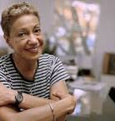
June Jorndan

Slide 8
June Jordan
One of the most widely-published and highly-acclaimed bisexual Jamaican American writers of her generation, poet, playwright and essayist June Jordan was known for her fierce commitment to human rights and political activism.
Born July 9, 1936, in Harlem, New York, Jordan had a difficult childhood and an especially fraught relationship with her father. Her parents were both Jamaican immigrants.

Slide 9
Poem about My Rights
BY JUNE JORDAN
I am very
familiar with the problems because the problems
turn out to be
me
I am the history of rape
I am the history of the rejection of who I am
I am the history of the terrorized incarceration of
myself
I am the history of battery assault and limitless
armies against whatever I want to do with my mind
and my body and my soul and
whether it’s about walking out at night
or whether it’s about the love that I feel{...}
I have been raped
because I have been wrong the wrong sex the wrong age
the wrong skin the wrong nose the wrong hair the
wrong need the wrong dream the wrong geographic
the wrong sartorial

Slide 10
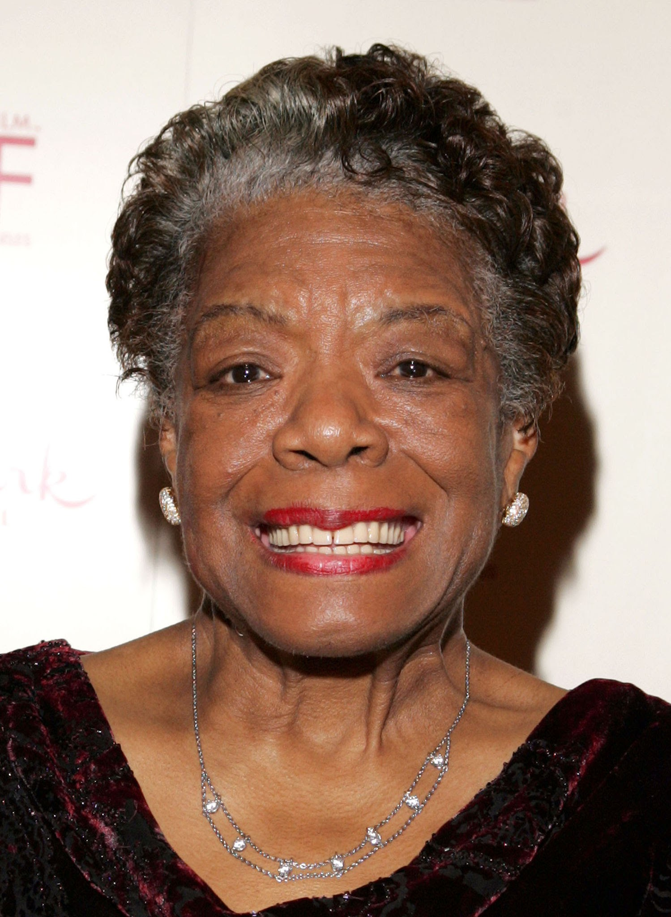
Maya Angelou
Maya Angelou, original name Marguerite Annie Johnson, (born April 4, 1928, St. Louis,U.S.—died May 28, 2014, Winston-Salem, North Carolina), American poet, memoirist, and actress whose several volumes of autobiography explore the themes of economic, racial, and sexual oppression.
When she was not yet eight years old, she was raped by her mother’s boyfriend and told of it, after which he was murdered; the traumatic sequence of events left her almost completely mute for several years. This early life is the focus of her first autobiographical work, I Know Why the Caged Bird Sings (1969)
Presidential Medal Of Freedom (2011)
Grammy Awards

Slide 11
Notes
The poem “I Know Why The Caged Bird Sings” contrasts the lives of two birds – one free and one caged. The free bird represents white society in America while the caged bird is the black American. With his wings clipped and feet tied, all the bird can do is sing:

Slide 12
“I Know Why The Caged Bird Sings” – Maya Angelou
The caged bird sings
with a fearful trill
of things unknown
but longed for still
and his tune is heard
on the distant hill
for the caged bird
sings of freedom

Slide 13
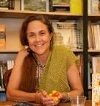
Naomi Shihab Nye
Naomi Shihab Nye was born on March 12, 1952, in St. Louis, Missouri, to a Palestinian father and an American mother. During her high school years, she lived in Ramallah in Palestine, the Old City in Jerusalem, and San Antonio, Texas. Nye’s honors include many awards.
Nye gives voice to her experience as an Arab-American through poems about heritage and peace that overflow with a humanitarian spirit.

Slide 14
Before I was Gazan
I was a boy
and my homework was missing,
paper with numbers on it,
stacked and lined,
I was looking for my piece of paper,
proud of this plus that, then multiplied,
not remembering if I had left it
on the table after showing to my uncle
or the shelf after combing my hair
but it was still somewhere
and I was going to find it and turn it in,
make my teacher happy,
make her say my name to the whole class,
before everything got subtracted
in a minute
even my uncle
even my teacher
even the best math student and his baby sister
who couldn’t talk yet.
And now I would do anything
for a problem I could solve

Slide 15
Nikki Rosa
childhood remembrances are always a drag
if you’re Black
you always remember things like living in Woodlawn
with no inside toilet
and if you become famous or something
they never talk about how happy you were to have
your mother
all to yourself and
how good the water felt when you got your bath
from one of those
big tubs that folk in chicago barbecue in
and somehow when you talk about home
it never gets across how much you
understood their feelings
as the whole family attended meetings about Hollydale
and even though you remember
your biographers never understand
your father’s pain as he sells his stock
and another dream goes
And though you’re poor it isn’t poverty that
concerns you
and though they fought a lot
it isn’t your father’s drinking that makes any difference
but only that everybody is together and you
and your sister have happy birthdays and very good
Christmases
and I really hope no white person ever has cause
to write about me
because they never understand
Black love is Black wealth and they’ll
probably talk about my hard childhood
and never understand that
all the while I was quite happy

Slide 16
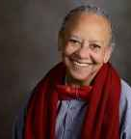
Nikki Giovanni
Nikki Giovanni, byname of Yolande Cornelia Giovanni, Jr., (born June 7, 1943, Knoxville, Tennessee, U.S.), American poet whose writings ranged from calls for black power to poems for children and intimate personal statements.

