Slide 1
ΠΡΟΓΡΑΜΜΑΤIΖΟΝΤΑΣ με το scratch
ΒΙΚΥ ΜΥΡΩΝΗ
myroni@csd.auth.gr

Slide 2
Επισκόπηση του Scratch
Δημιουργήθηκε από το MIT το 2007
Γράφτηκε στη γλώσσα Squeak
100% GUI based programming environment
Αντικειμενοστραφές περιβάλλον
Μεταγλωττισμένο
Multi-threaded
Cross-System. Τρέχει σε Windows, Mac, Linux
Είναι δωρεάν!
Notes:
Scratch is not completely object-oriented by definition, but it does require an object-oriented approach/mindset. Scratch is not only interpreted, it’s interpreted on the fly! This means that the source code can be changed during execution and the changes will be effective immediately.
Ενδεικτικά μπορούμε να αναφέρουμε ότι στην ιστοσελίδα του Scratch (http://scratch.mit.edu/) υπάρχουν γύρω στα 700.000 εγγεγραμμένα μέλη και γύρω στους 200.000 προγραμματιστές που δημοσιεύουν τα προγράμματά τους στον συγκεκριμένο ιστοχώρο!

Slide 3
Session 1

Slide 4
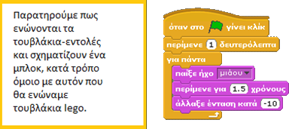
Scratch Interface
Η διεπιφάνεια του Scratch χωρίζεται σε 4 μεγάλα τμήματα.

Slide 5
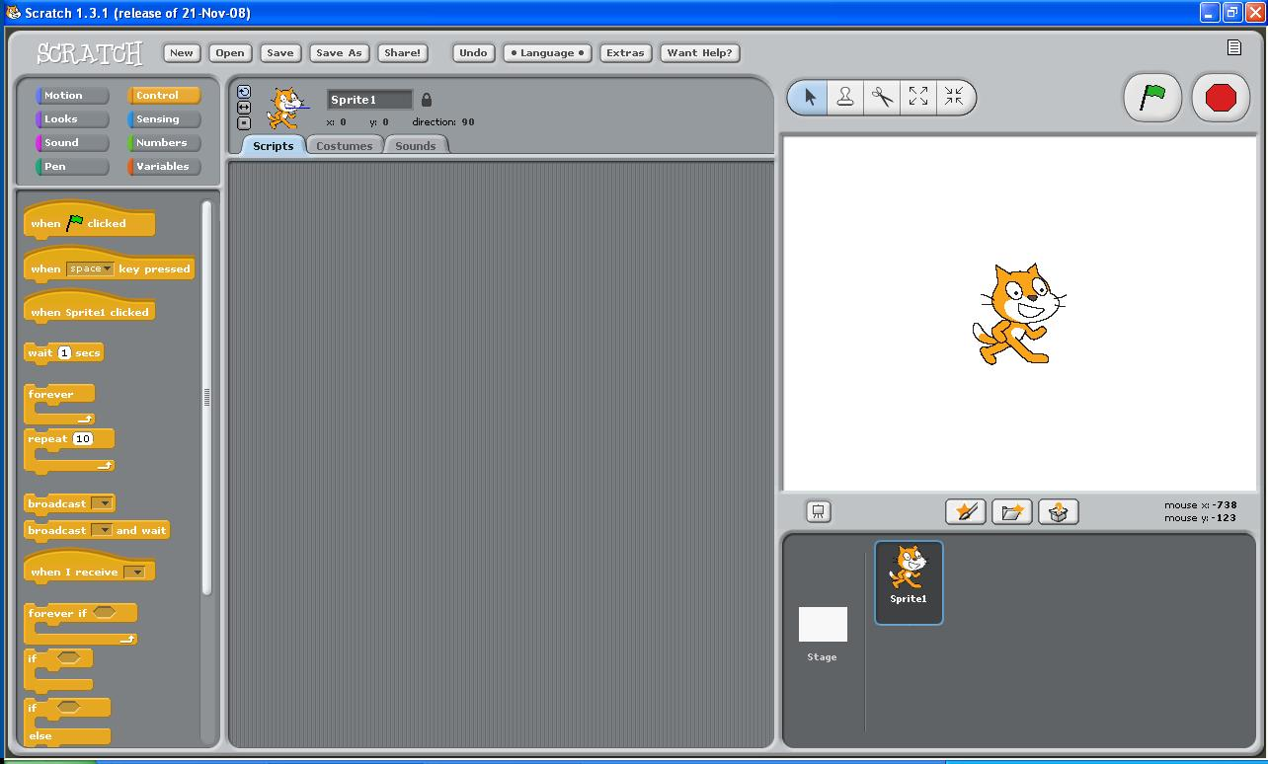

Slide 6
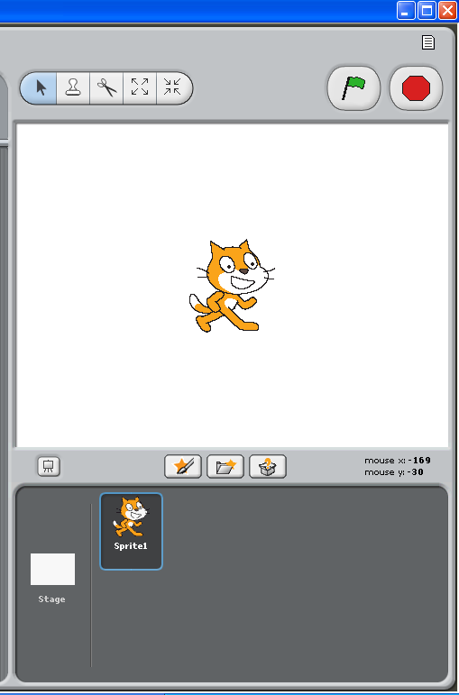
Mε, Clone, Cut, Change Shape
Αρχή και Τέλος
Διεπαφή
Δημιούργησε, βρες ή βάλε έναν χαρακτήρα έκπληξη
ΘΕΣΗ ΧΑΡΑΚΤΗΡΩΝ
Full Screen
Λίστα Χαρακτήρων
Stage

Slide 7
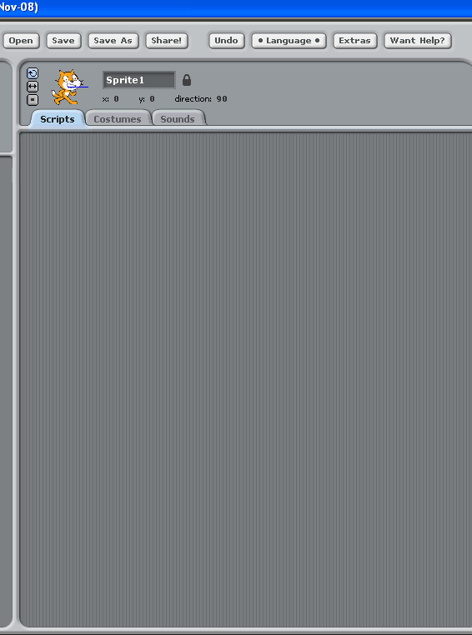
Περιοχή
Εντολών

Slide 8
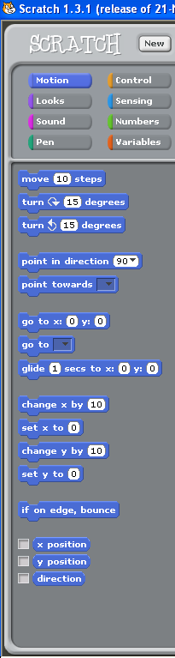

Blocks

Slide 9
Notes:
Με το εικονίδιο γλώσσας (το πρώτο από αριστερά) αλλάζετε τη γλώσσα της επιφάνειας εργασίας του Scratch.
Με το εικονίδιο αποθήκευσης (το δεύτερο από αριστερά) αποθηκεύετε το έργο σας.
Με το εικονίδιο μοιράσματος (το τρίτο από αριστερά) ανεβάζετε το έργο σας στον ιστοχώρο του Scratch και το δημοσιοποιείτε στο διαδίκτυο.
Από το μενού Αρχείο μπορείτε να δημιουργήσετε ένα νέο έργο, να ανοίξετε ένα αποθηκευμένο έργο και να αποθηκεύσετε το τρέχον έργο σας.
Εισαγωγή έργου: εισάγει όλες τις μορφές και τα υπόβαθρα

Slide 10
Day 3
Explore http://scratch.mit.edu
Set up an account.
Download three games that are similar to the ones that you want to create.
See how these games are coded.
Save a game to your web account.

Slide 11

First Program
Enough talk, let’s start programming!
Select the only sprite in the lower right corner and make sure the scripts area is being displayed
Click the “Control” blocks category and drag a to the script area. This block is used in most programs and serves as a starting point for the other blocks and/or scripts
Click the “Motion” category and place the block directly underneath the other block already in the scripts area. The two blocks will join which means they will be executed one right after the other. Connected blocks such as these are called scripts. Blocks are the most basic element of a Scratch script
Click the green flag near the stage and watch the sprite!
That’s it! You have written your first scratch program!

Slide 12
Digging a little deeper
Let’s take a closer look at what’s going on in the program we just made
There are actually two objects that exist in the project, the cat named “Sprite1” and the stage
The small script we created was placed in the scripts area of sprite1 which means that the move block in the script will affect sprite1 and only sprite1. This behavior is the foundation of object-oriented programming
Sprites/objects in scratch are made up of two main elements: state (position, size, variables, current costume, etc.) and scripts. These two elements closely resemble the makeup of an object in other languages such as Java, C++ and even Alice

Slide 13
Double the excitement
Multi-threaded programs are easy to write in Scratch
We moved one sprite in the last example. Now let’s try to move two sprites at the same time
Copy the sprite by right clicking on it in the sprite list and selecting “duplicate.” You will notice that not only is the sprite copied, the scripts associated with that sprite are as well
Reposition the sprites by dragging them until they are no longer touching (this is so we can see the movement more clearly)
Click the green flag to test the program. If the sprites don’t appear to move, try increasing the number of steps in the move blocks

Slide 14
A few things to consider
You might have noticed that each sprite had to have its own script in order to move. This may seem unnecessary at first, but this behavior is crucial if objects are to remain isolated from each other. If sprites need to communicate, Scratch has certain provisions, but it is left up to the programmer to determine when and where they should be used. We will cover this in greater depth in session 6.
The two main elements of a Sprite/Object is it’s state such as costume, color, etc. and it’s scripts.
Object creation and deletion in Scratch and Alice is slightly different than in other languages. In Scratch, the programmer has to manually create or delete a sprite before the program is executed, but in other languages those tasks can be accomplished by the program while the program is running.

Slide 15
Session 1 Questions
What is the most basic element of a scratch script?
What are the two main elements of a(n) Sprite/Object?
Can an object affect another object without you, the programmer, specifically allowing it?
In a script, in what order are blocks executed?
Can multiple scripts/methods run at the same time?
In Scratch, can objects/sprites be created, destroyed, or deleted once the program has started?

